Slide 1
EMF & Health
Jeffrey M. Ellenbogen, MD
22 October 2025
Notes:
© 2025 Jeffrey Ellenbogen, all rights reserved.

Slide 2

Roadmap
Health
Electromagnetic interference (EMI)
Noise (corona discharge)
Q & A / Roleplay

Slide 3
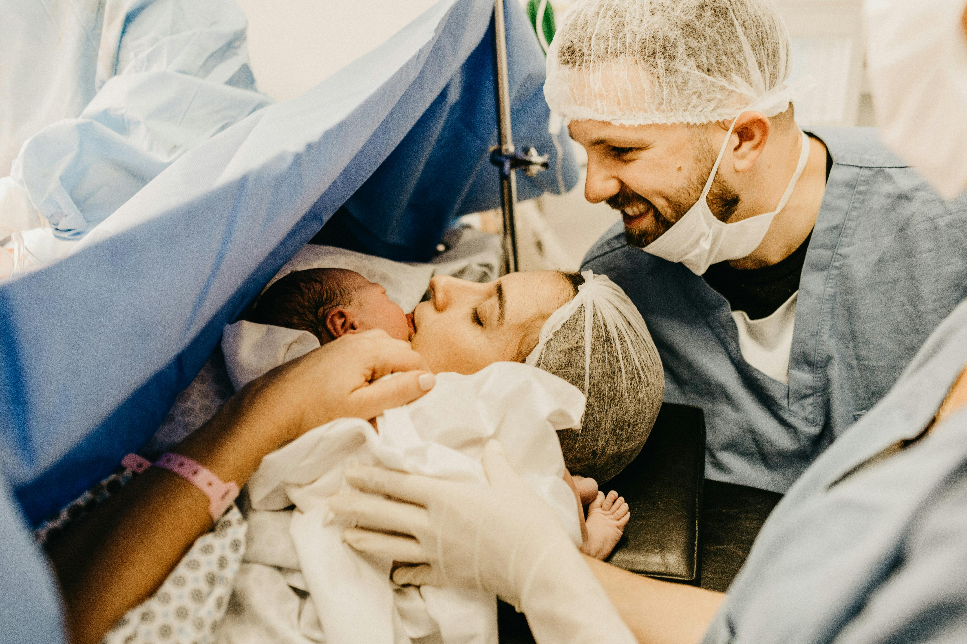

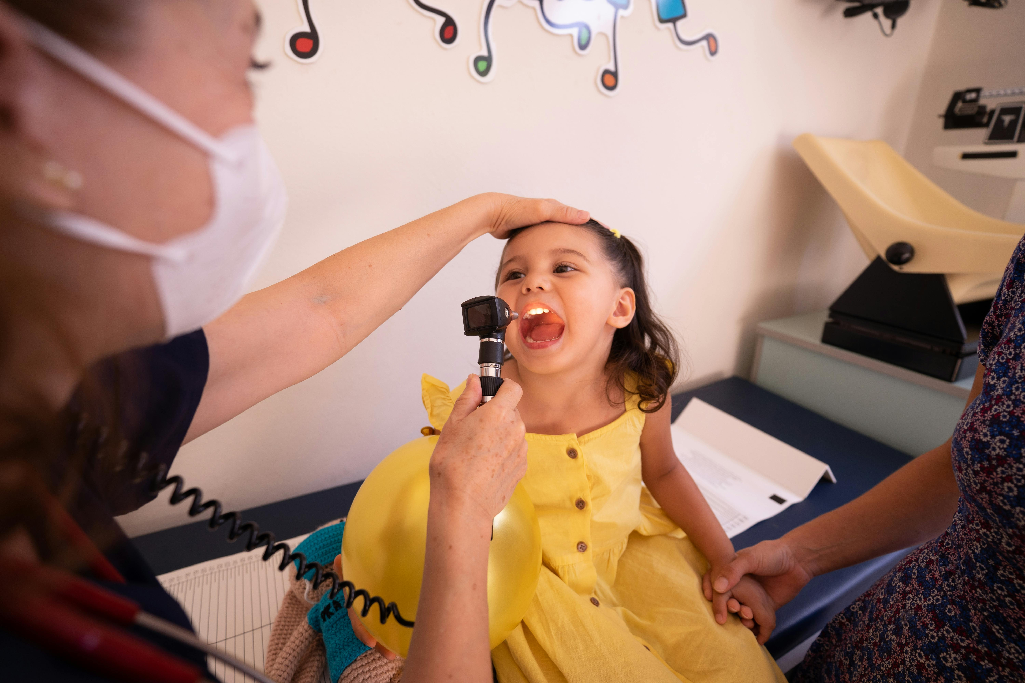
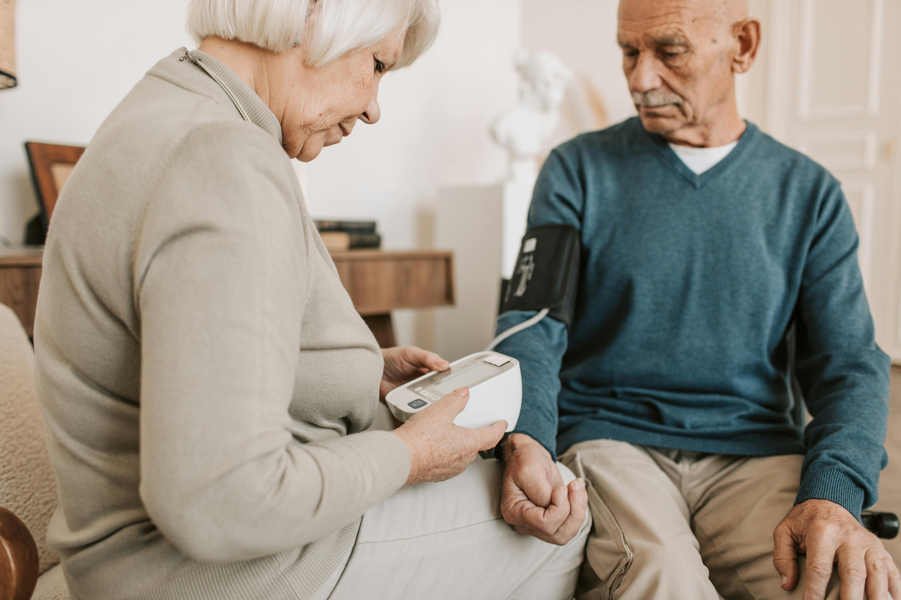



Notes:
It’s not just buildings and light bulbs, it’s the human experience which is so entrenched with the need for power for optimization health and wellness.
But while you’re busy building things that will improve lives (and save them), others are building a case for why you are causing harm, including death in children from leukemia.
Armed with statements like “possible carcinogen” from organizations such as WHO. Are they right? How would I know? How can I communicate my findings with the public? With commissioners?
That is the subject of today’s discuss.
Let’s begin. First, with a road map

Slide 4
READ MEDICAL LITERATURE LIKE AN EXPERT Real-World Scientific Method
1. Meaningful Problem | 6. Temporal Relationship
2. Biological Plausibility | 7. Dose Response
3. Hypothesis | 8. Reproducibility
4. Study design / Conduct | 9. Effect size
5. Validity | 10. Peer review
Meaningful problem
Biological plausibility
Hypothesis
Study design & conduct
Validity assessment
6. Temporal relationship
7. Dose response
8. Reproducibility
9. Effect size
10. Peer review / Expert
Notes:
Meaningful problem: kids get cancer
Bio plaus: what are the key factors that might drive the finding
Hypothesis generation: 1979 vs post 1979
Design: RCT vs Observational
Validity: internal (chance, bias, confounding); external (generalizability)
Chance (confidence intervals
Bias (stack the deck
Confound: missing the key factor (Does ice cream consumption cause drowning)
Temporal relationship is about causality (correlation v causation)
Dose response
Reproducible (not just same inner circle)
Effect size: 100% raise from $1/hr to $2/hr
Peer review / Expert opinion

Slide 5
Study Design
Experimental Studies
Randomized Controlled Trials (RCTs)
Active control
Observational Studies
Case-Control Studies
Cohort Studies
Passive

Slide 6
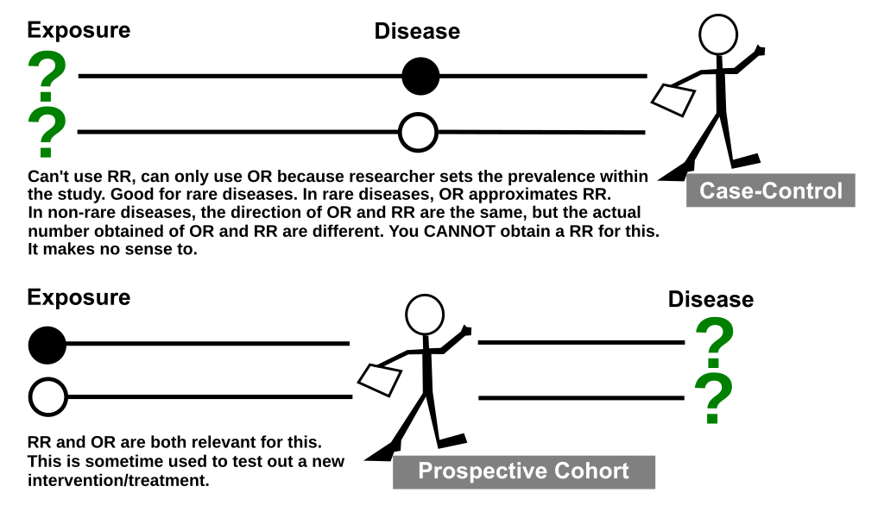
Notes:
Source: wiki

Slide 7
Case-Control Study
Odds Ratio = (a/b) ÷ (c/d) = (a × d) / (b × c)
Breaking it down:
a/b = odds of exposure among cases
c/d = odds of exposure among controls
You're comparing these two odds
Given cases of kids with leukemia [compared to healthy], what are the odds that they were exposed to magnetic fields?
 | Exposed | Not Exposed
Cases | a | b
Controls | c | d
Odds Ratio = (a/b) ÷ (c/d)

Slide 8
Confidence Interval (CI)
The Odds Ratio is somewhere in this range.
If it spans 1, than the study is not significant (“NS”)

Slide 9
Example: Non-Significant Results Gervasi et al. 2019
EMF exposure living near powerline
Alzheimer's dementia: OR = 1.11 (95% CI: 0.95-1.30)
Parkinson's disease: OR = 1.09 (95% CI: 0.92-1.30)
Authors’ incorrect spin:
"The finding of a weak association..."
Notes:
Gervasi F, et al. Residential distance from high-voltage overhead power lines and risk of Alzheimer's dementia and Parkinson's disease: a population-based case-control study in a metropolitan area of Northern Italy. Int J Epidemiol. 2019
Full URL: https://academic.oup.com/ije/article/48/6/1949/5529302

Slide 10

1/3rd of all childhood malignancies
most common form of cancer in children
Notes:
ACUTE LYMPHOBLASTIC LEUKEMIA
ALL/LBL accounts for approximately one-third of all childhood malignancies and is the most common form of cancer in children; ALL/LBL is five times more common in children than acute myeloid leukemia (AML) [1,2]. The distribution of ALL/LBL categories is B lineage (85 percent), T lineage (10 to 15 percent), and NK lineage (<1 percent).
Approximately 3000 new cases of ALL/LBL are diagnosed in children each year in the United States, with an incidence of approximately 3.4 cases per 100,000 [1]. The incidence varies worldwide but this may be influenced, in part, by diagnostic and reporting differences [3]. In the United States, the incidence of ALL/LBL is higher in Latino and White individuals than in Black and Asian individuals [4,5]. The peak incidence of ALL/LBL occurs between ages two to five years, and it is more common among boys than girls [1,4,6,7].
The incidence of childhood leukemia appears to be increasing
Lymphoid → the “smart” immune cells that recognize specific targets (Bs and Ts)
Myeloid → the “frontline” cells that do general defense, plus red blood cells and platelets.
Leukemias are named after which branch goes wrong:
ALL: malignant overgrowth of lymphoid precursors (immature B or T cells).
AML: malignant overgrowth of myeloid precursors (cells that should become red cells, platelets, or granulocytes).

Slide 11
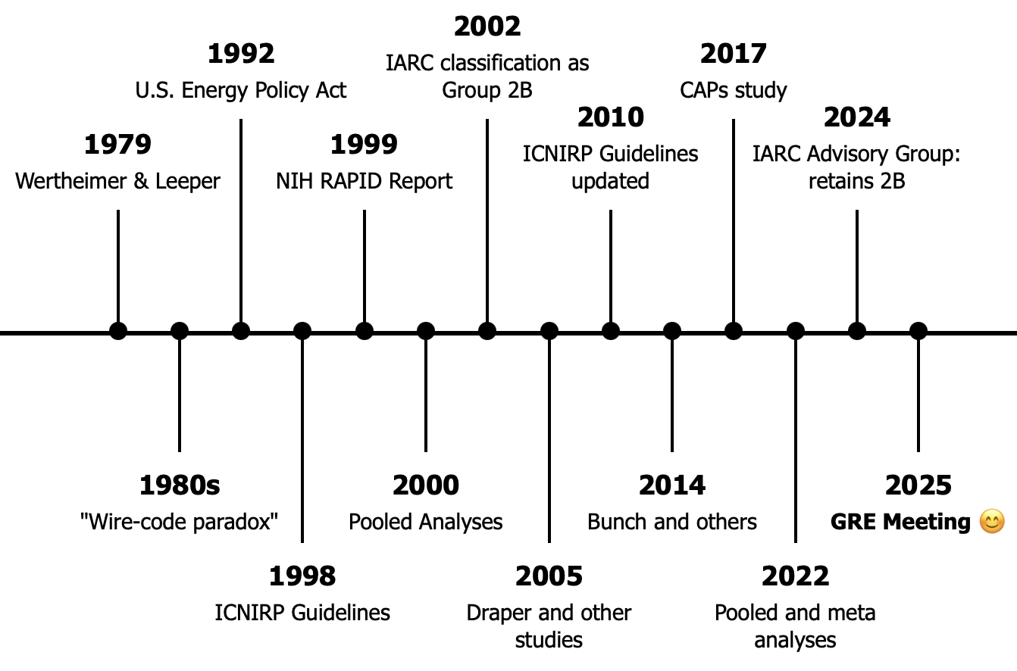



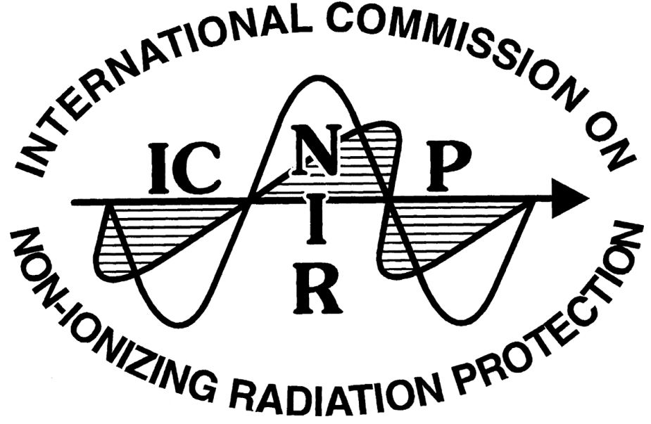



Slide 12
The Beginning Wertheimer N, Leeper E. 1979
Case-control study
childhood cancer vs. controls
1950-1973
Exposure: "Wire code"
No magnetic field measurements
OR ≈ 2.0-3.0 for cancer
Chance:
poor stats rigor
No biological plausibility
Bias
unblinded
Confounding
Socioeconomics etc
Notes:
Citation
Wertheimer N, Leeper E. Electrical wiring configurations and childhood cancer. Am J Epidemiol. 1979;109(3):273-284.
https://pubmed.ncbi.nlm.nih.gov/453167/
Wertheimer and Leeper's paper launched the field of EMF epidemiology. They noticed that homes near certain power line configurations had more childhood cancer deaths and developed "wire codes" - categories based on the type and proximity of electrical wiring near homes.
Confounding?
Critical insight on wire codes: While wire codes correlate with magnetic fields, they also correlate with many other factors: socioeconomic status (wealthier neighborhoods have underground wiring), housing age (older homes near surface streets have more overhead lines), urban density, and traffic density. This confounding makes it impossible to determine if associations reflect magnetic fields or these other factors.
Biological plausibility was completely absent - no proposed mechanism for how 50-60 Hz magnetic fields at microtesla levels could cause cancer. No animal models supported the association. The study was purely observational pattern recognition.
The temporal relationship problem: Using death certificates rather than birth addresses means we don't know if children lived near power lines before diagnosis or moved there afterward. For diseases with long latency like leukemia, establishing that exposure preceded disease is critical.
Historical context: In 1979, direct magnetic field measurement devices were not readily available for epidemiological studies. Wire codes were a practical, if imperfect, solution. Savitz (1988) would later add actual measurements.
Bottom line: Important for raising the question, but methodologically limited. Requires replication with better exposure assessment and control of confounding. This is exactly what subsequent research attempted to do.

Slide 13
Savitz et al. 1988 - Childhood Cancer
Addresses blinding problem
Measures magnetic fields
Notes:
Savitz DA, Wachtel H, Barnes FA, John EM, Tvrdik JG. Case-control study of childhood cancer and exposure to 60-Hz magnetic fields. Am J Epidemiol. 1988;128(1):21-38.
https://pubmed.ncbi.nlm.nih.gov/3164167/
Directly addressed W&L's main weakness by conducting blinded assessment
Field measurements taken under two conditions: low power (nighttime, minimal appliances) and high power (daytime, appliances on)
Low power measurements thought to better represent chronic background exposure
Wire code results similar to W&L, suggesting replication
Weaker association with measured fields puzzling - suggested either wire codes capture something beyond current magnetic fields, or measurement error in spot measurements
Authors noted limitations: nonresponse for field measurements, differential mobility between cases and controls, exposure misclassification from imperfect surrogates
Study encouraged further research but fell short of demonstrating causation
Led to decades of research trying to resolve wire code vs. measured field discrepancy

Slide 14
Savitz et al. 1988 - Childhood Cancer
Paradoxical Results:
Wire codes: yes
Measured fields: no
Authors spin: “…the results encourage further examination of the carcinogenic potential…”
Notes:
What should have provided some relief, instead gave deeper concern due to spin

Slide 15
1990s – addressing public concern
1992 Energy Policy Act
Congress launches EMF RAPID program
Directs NIH to evaluate health effects.

Slide 16
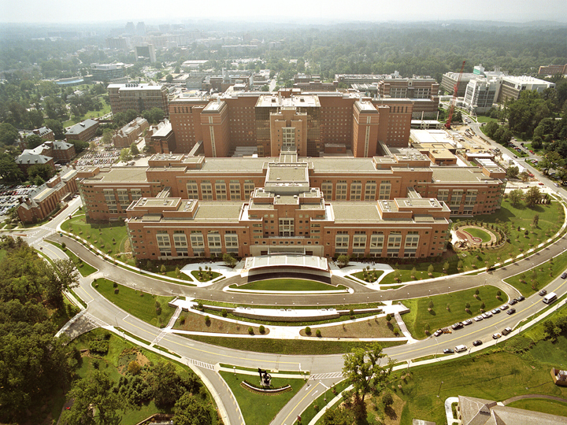

Slide 17
NIH –National Institutes of Health
Federal agency
Conducts and supports medical research
27 institutes
Two institutes address ELF EMF health effects:
NIEHS - National Institute of Environmental Health Sciences
NCI - National Cancer Institute
Notes:
SOURCES
NIEHS
NIEHS EMF webpage (accessed October 2025): https://www.niehs.nih.gov/health/topics/agents/emf
NIEHS 1999 Report: https://www.niehs.nih.gov/health/assets/docs_p_z/report_powerline_electric_mg_predates_508.pdf
NIEHS published a definitive 67-page report in 1999 to Congress assessing health effects from power-line frequency electric and magnetic fields. This report represented the most comprehensive U.S. research effort on ELF-EMF health effects.
NCI
NCI provides ongoing public health information and evaluates cancer risks from electromagnetic field exposures, regularly updating their fact sheets to reflect current scientific understanding.
NCI EMF Fact Sheet (reviewed October 2022, accessed October 2025): https://www.cancer.gov/about-cancer/causes-prevention/risk/radiation/electromagnetic-fields-fact-sheet

Slide 18
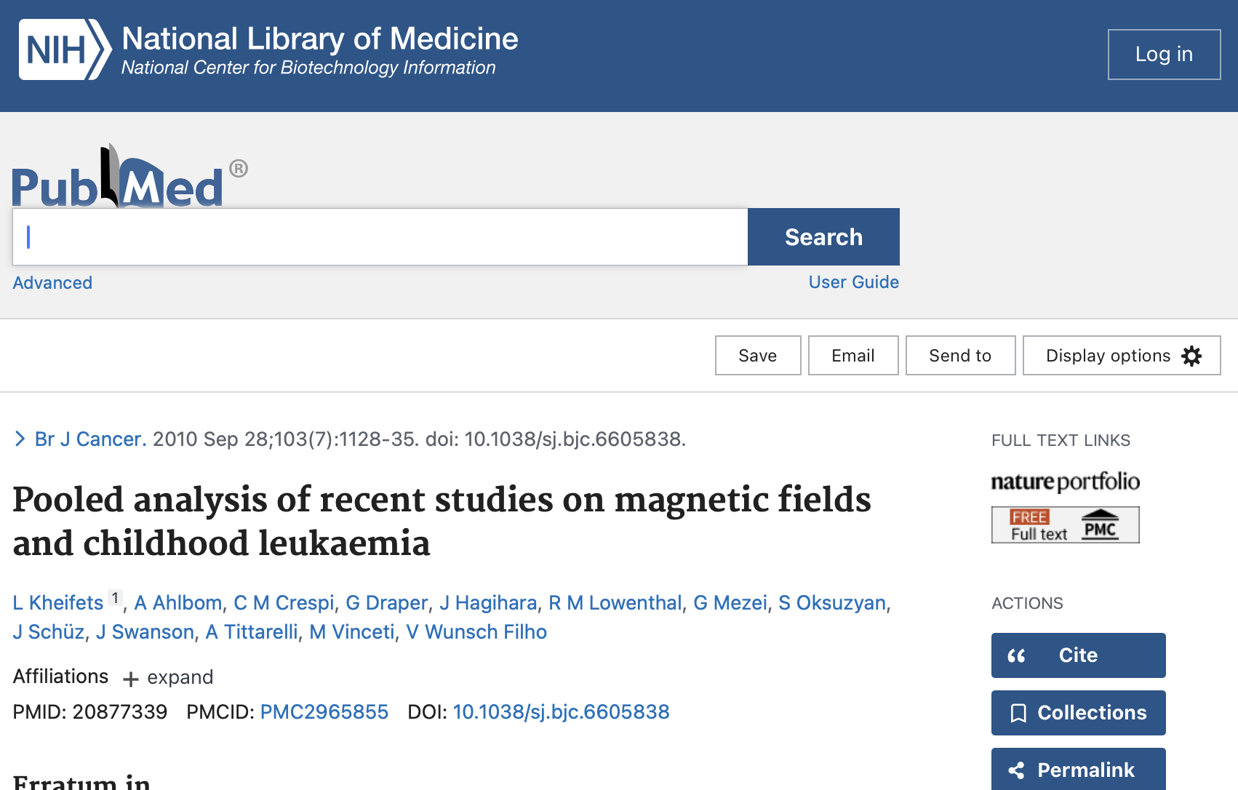

Slide 19

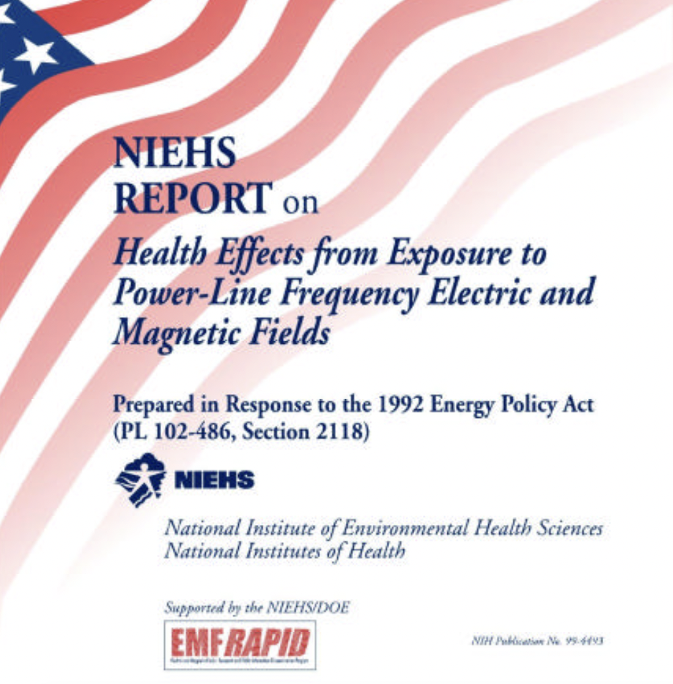

Notes:
EMF-RAPID
Electric and Magnetic Fields (EMF) Research and Public Information Dissemination (RAPID) Program

Slide 20
Notes:
EMF-RAPID
Electric and Magnetic Fields (EMF) Research and Public Information Dissemination (RAPID) Program

Slide 21

1999 Report to Congress:
”Conclusion: The scientific evidence suggesting that ELF-EMF exposures pose any health risk is weak.”
"The strongest evidence for health effects comes from associations observed in human populations with two forms of cancer: childhood leukemia and chronic lymphocytic leukemia in occupationally exposed adults."
Notes:
Sources:
NIEHS EMF webpage (accessed October 2025): https://www.niehs.nih.gov/health/topics/agents/emf
NIEHS 1999 Report: https://www.niehs.nih.gov/health/assets/docs_p_z/report_powerline_electric_mg_predates_508.pdf
NCI EMF Fact Sheet (reviewed October 2022, accessed October 2025): https://www.cancer.gov/about-cancer/causes-prevention/risk/radiation/electromagnetic-fields-fact-sheet
NIEHS Position (1999 - Page ii, Executive Summary):
"The lack of connection between the human data and the experimental data (animal and mechanistic) severely complicates the interpretation of these results." Laboratory evidence in animals and humans and mechanistic work in cells failed to support a causal relationship between ELF-EMF exposure at environmental levels and disease.
“The NIEHS concludes that ELF-EMF exposure cannot be recognized at this time as entirely safe because of weak scientific evidence that exposure may pose a leukemia hazard. In my opinion, the conclusion of this report is insufficient to warrant aggressive regulatory concern. However, because virtually everyone in the United States uses electricity and therefore is routinely exposed to ELF-EMF, passive regulatory action is warranted such as a continued emphasis on educating both the public and the regulated community on means aimed at reducing exposures. The NIEHS does not believe that other cancers or non-cancer health outcomes provide sufficient evidence of a risk to currently warrant concern.

Slide 22
1999 Report to Congress:
”Conclusion: The scientific evidence suggesting that ELF-EMF exposures pose any health risk is weak.”
"The strongest evidence for health effects comes from associations observed in human populations with two forms of cancer: childhood leukemia and chronic lymphocytic leukemia in occupationally exposed adults."
Notes:
Sources:
NIEHS EMF webpage (accessed October 2025): https://www.niehs.nih.gov/health/topics/agents/emf
NIEHS 1999 Report: https://www.niehs.nih.gov/health/assets/docs_p_z/report_powerline_electric_mg_predates_508.pdf
NCI EMF Fact Sheet (reviewed October 2022, accessed October 2025): https://www.cancer.gov/about-cancer/causes-prevention/risk/radiation/electromagnetic-fields-fact-sheet
NIEHS Position (1999 - Page ii, Executive Summary):
"The lack of connection between the human data and the experimental data (animal and mechanistic) severely complicates the interpretation of these results." Laboratory evidence in animals and humans and mechanistic work in cells failed to support a causal relationship between ELF-EMF exposure at environmental levels and disease.
“The NIEHS concludes that ELF-EMF exposure cannot be recognized at this time as entirely safe because of weak scientific evidence that exposure may pose a leukemia hazard. In my opinion, the conclusion of this report is insufficient to warrant aggressive regulatory concern. However, because virtually everyone in the United States uses electricity and therefore is routinely exposed to ELF-EMF, passive regulatory action is warranted such as a continued emphasis on educating both the public and the regulated community on means aimed at reducing exposures. The NIEHS does not believe that other cancers or non-cancer health outcomes provide sufficient evidence of a risk to currently warrant concern.

Slide 24
ICNIRP
Independent, non-profit, scientific organization
develop and publish guidelines for non-ionizing radiation
governments and standards bodies may adopt
(Most of EU does.)
not a regulator
Notes:
Independent, non-profit, scientific organization
develop guidelines for non-ionizing radiation (from 1 Hz ELF through RF and light).
publishes guidance (that governments and standards bodies may adopt)
not a regulator

Slide 25
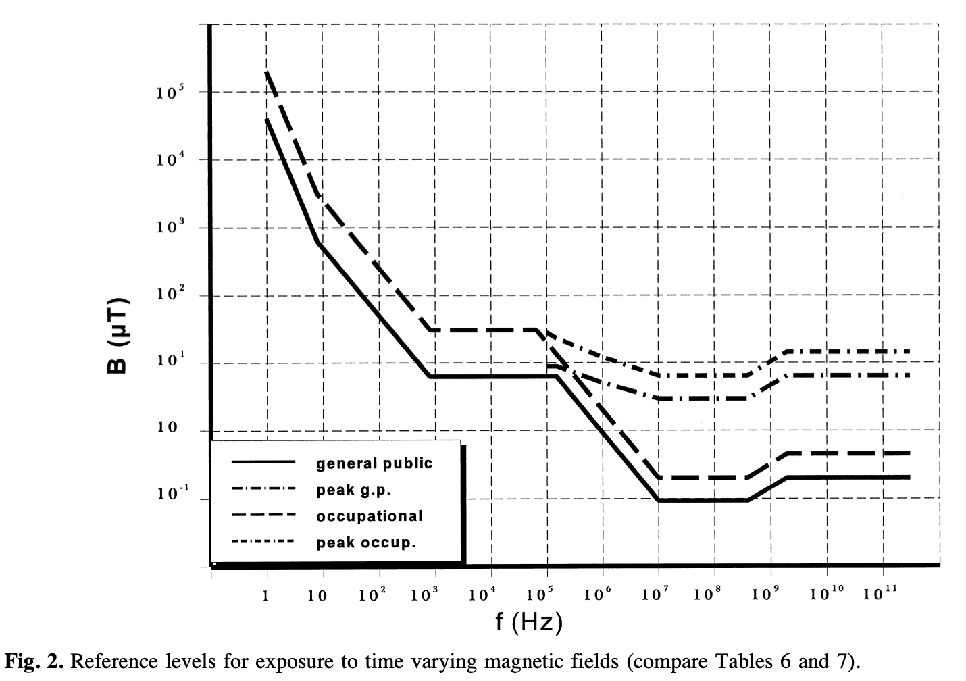
ICNIRP 1998, Magnetic Field Limits
Notes:
Source:
https://www.icnirp.org/cms/upload/publications/ICNIRPemfgdl.pdf
ICNIRP 1998 Public B Field Limits
Table 7 (p. 511) and Fig 2 (p. 512): Reference levels for general public exposure at ELF (0.025–0.8 kHz).
Formula: B = 5/f (µT), with f in kHz.
At 50 Hz (0.05 kHz): 100 µT (1,000 mG).
At 60 Hz (0.06 kHz): ≈83 µT (830 mG).
Occupational (Table 6, same page): 500 µT (5,000 mG) at 50 Hz, ≈417 µT (4,170 mG) at 60 Hz.
*Source: ICNIRP (1998), Guidelines on EMF exposure, Health Physics, 74(4), p. 511–512.

Slide 26
ICNIRP 1998, Magnetic Field Limits
83 µT (830 mG) at 60 Hz
417 µT (4,170 mG) at 60 Hz
Notes:
Source:
https://www.icnirp.org/cms/upload/publications/ICNIRPemfgdl.pdf
ICNIRP 1998 Public B Field Limits
Table 7 (p. 511) and Fig 2 (p. 512): Reference levels for general public exposure at ELF (0.025–0.8 kHz).
Formula: B = 5/f (µT), with f in kHz.
At 50 Hz (0.05 kHz): 100 µT (1,000 mG).
At 60 Hz (0.06 kHz): ≈83 µT (830 mG).
Occupational (Table 6, same page): 500 µT (5,000 mG) at 50 Hz, ≈417 µT (4,170 mG) at 60 Hz.
*Source: ICNIRP (1998), Guidelines on EMF exposure, Health Physics, 74(4), p. 511–512.

Slide 27
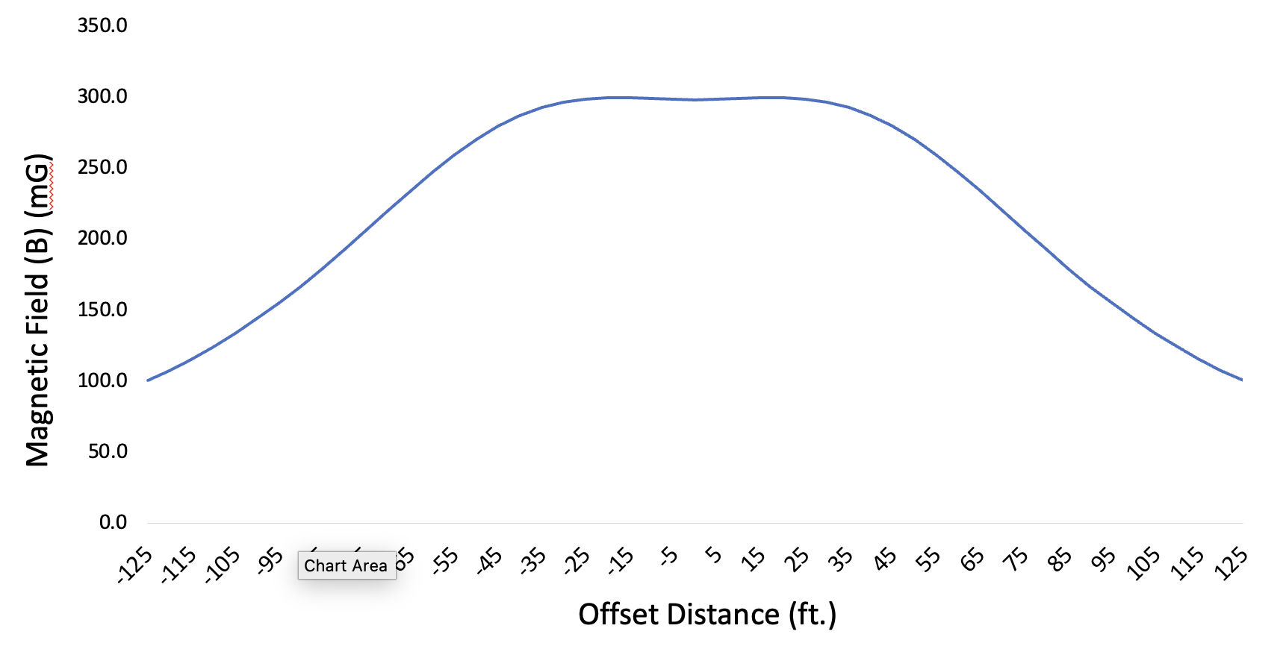
Magnetic Field (B Field)
Notes:
Speaker Notes – B Field (No Threshold)
This figure shows modeled magnetic-field strength (mG, left axis; µT, right axis) versus horizontal offset (ft) from the 765 kV line centerline.
No thresholds are shown; this is the baseline profile for comparison.
Legend shows modeled vertical clearances in feet.
@ 1 m above ground level
Now let’s put the ICNIRP threshold on that chart and see where it compares…[next slide]

Slide 28
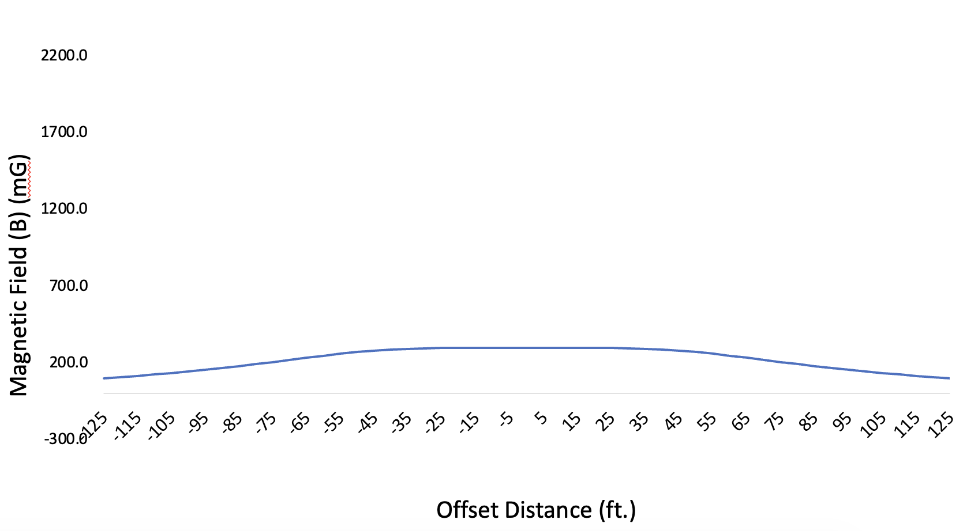
Magnetic Field (B Field)
ICNIRP 2010 (2000 mG)
ICNIRP 1998 (830 mG)
PowerOn (300 mG)
Notes:
Speaker Notes – B Field (No Threshold)
This figure shows modeled magnetic-field strength (mG, left axis; µT, right axis) versus horizontal offset (ft) from the 765 kV line centerline.
No thresholds are shown; this is the baseline profile for comparison.
Legend shows modeled vertical clearances in feet.
@ 1 m above ground level
Now let’s put the ICNIRP threshold on that chart and see where it compares…[next slide]

Slide 29
Going Well in late 90’s
NIH – “weak” finding
NEJM – major null result + editorial
ICNIRP – guideline (830 mg vs your 300)
Europe – most member states use ICNIRP

Slide 30
But: Y2K

Slide 31

2000 — Pooled Analyses
Two major pooled analyses published in 2000 both found elevated risk of measured magnetic fields
Notes:
Ahlbom A, et al. A pooled analysis of magnetic fields and childhood leukaemia. British Journal of Cancer. 2000
https://www.nature.com/articles/6691376
Greenland S, Sheppard AR, Kaune WT, Poole C, Kelsh MA, for the Childhood Leukemia-EMF Study Group. A pooled analysis of magnetic fields, wire codes, and childhood leukemia. Epidemiology. 2000
https://www.jstor.org/stable/3703814

Slide 32
Meta-Analysis & Pooled Analysis
Meta-Analysis
Combines published summary statistics from multiple studies
Uses only what's published in papers
Pooled Analysis
Combines raw data from individual studies
Uses original patient-level data

Slide 33
2000 — Pooled Analyses
Ahlbom A, et al. 2000
“A pooled analysis of magnetic fields and childhood leukaemia.”
British Journal of Cancer.
Greenland S, et al 2000
“A pooled analysis of magnetic fields, wire codes, and childhood leukemia.”
Epidemiology.
Notes:
Ahlbom A, et al. A pooled analysis of magnetic fields and childhood leukaemia. British Journal of Cancer. 2000
https://www.nature.com/articles/6691376
Greenland S, Sheppard AR, Kaune WT, Poole C, Kelsh MA, for the Childhood Leukemia-EMF Study Group. A pooled analysis of magnetic fields, wire codes, and childhood leukemia. Epidemiology. 2000
https://www.jstor.org/stable/3703814

Slide 34
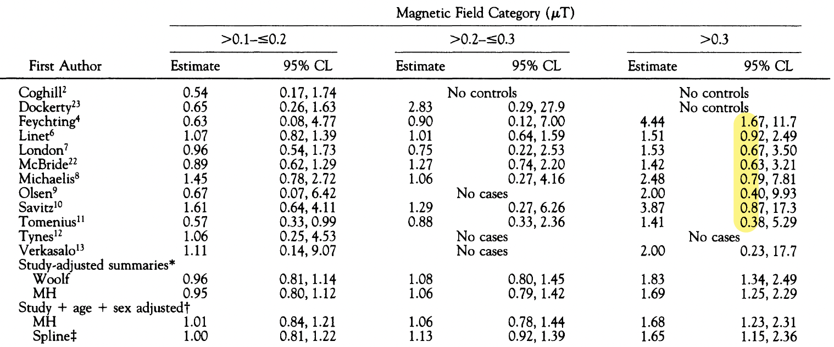
Step 3—Pooled Analyses
Most of shared studies were themselves null results.
Notes:
Only ONE study had statistically significant results:
Feychting: OR = 4.44 (95% CI: 1.67-11.7)
All other studies had CIs crossing 1.0:
Linet: OR = 1.51 (0.92-2.87)
London: OR = 1.53 (0.67-3.50)
McBride: OR = 1.42 (0.63-3.21)
Michaelis: OR = 2.48 (0.79-7.81)
Olsen: OR = 2.00 (0.40-9.93)
Savitz: OR = 3.87 (0.87-17.3)
Tomenius: OR = 1.41 (0.38-5.29)
Verkasalo: OR = 2.00 (0.23-17.7)

Slide 35
Step 3—Pooled Analyses
Most of shared studies were themselves null results.
Notes:
Only ONE study had statistically significant results:
Feychting: OR = 4.44 (95% CI: 1.67-11.7)
All other studies had CIs crossing 1.0:
Linet: OR = 1.51 (0.92-2.87)
London: OR = 1.53 (0.67-3.50)
McBride: OR = 1.42 (0.63-3.21)
Michaelis: OR = 2.48 (0.79-7.81)
Olsen: OR = 2.00 (0.40-9.93)
Savitz: OR = 3.87 (0.87-17.3)
Tomenius: OR = 1.41 (0.38-5.29)
Verkasalo: OR = 2.00 (0.23-17.7)

Slide 36
Step 3—Pooled Analyses
Why impactful?
Both found similar ORs (~1.7-2.0) at high exposure
Wire-code paradox now gone
(Illusion of) two findings
Notes:
Getting rid of wire-code paradox meant – for proponents of findings -- less concern about confounding from wire codes
“The consistency of the epidemiological findings regarding childhood leukaemia and exposure to magnetic fields has been strengthened by two recent pooled analyses.” p. 338 in IARC 2002

Slide 38
IARC
International Agency for Research on Cancer (IARC)
Specialized cancer agency of the World Health Organization (WHO).
Coordinates and conducts research on causes and mechanisms of cancer.
“Group” system
1 (Carcinogenic to humans)
2A (Probably carcinogenic to humans)
2B (Possibly carcinogenic to humans)
3 (Not classifiable as to its carcinogenicity to humans)
Notes:
Important note: Group 4 ("Probably not carcinogenic") was removed in 2019 preamble update,, so there are now only 4 categories, not 5
Source: IARC About (accessed 2025): https://www.iarc.who.int/about-iarc/
“Limited evidence of carcinogenicity: a positive association has been observed between exposure to the agent and cancer for which a causal interpretation is considered credible, but chance, bias or confounding could not be ruled out with reasonable confidence.” p. 24 (Preamble)
“The consistency of the epidemiological findings regarding childhood leukaemia and exposure to magnetic fields has been strengthened by two recent pooled analyses.” p.338
1
Carcinogenic to humansThere is sufficient evidence that the agent causes cancer in humans.Tobacco smoking, asbestos, ionizing radiation, processed meats.
Group 2A
Probably carcinogenic to humansThere is limited evidence in humans and sufficient evidence in animals, or strong mechanistic evidence.
Group 2B
Possibly carcinogenic to humansThere is limited evidence in humans and less than sufficient evidence in animals, or other suggestive data.
pickled vegetables (traditional Asian)
Group 3
Not classifiable as to its carcinogenicity to humansThe evidence in humans and animals is inadequate or inconsistent. This does not mean “safe.”Caffeine, tea, static magnetic fields, coffee (since 2016).
Group 4(obsolete)
Probably not carcinogenic to humansUsed when there is strong evidence for lack of carcinogenicity in both humans and animals.

Slide 39
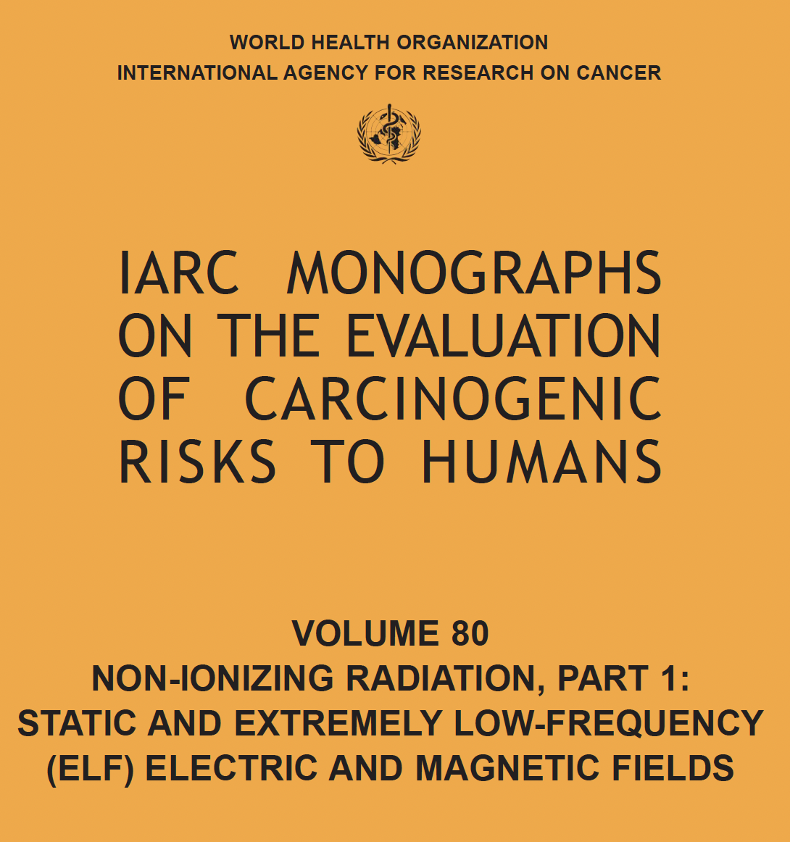
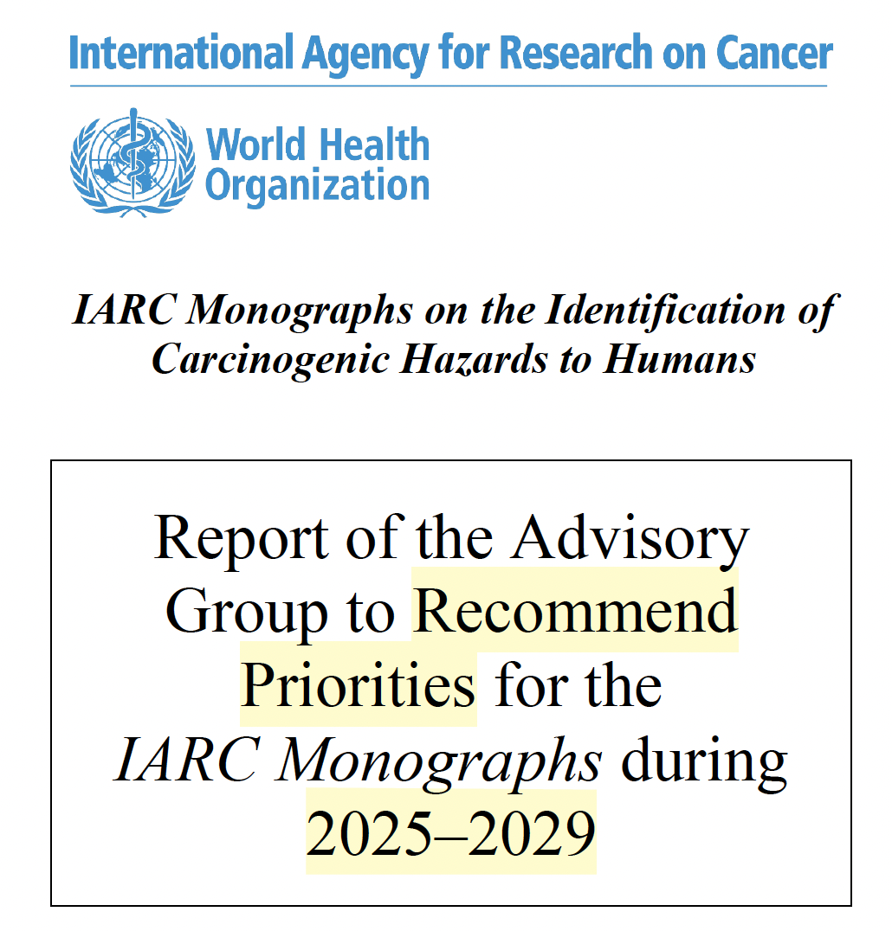
IARC – Key Documents to Know
2002
2024

Slide 41
IARC on ELF-MF 2002
"Extremely low-frequency magnetic fields are possibly carcinogenic to humans (Group 2B)."
"There is limited evidence in humans for the carcinogenicity of extremely low-frequency magnetic fields in relation to childhood leukaemia."
“…chance, bias, or confounding could not be ruled out with reasonable confidence.”
Notes:
Classification basis: Group 2B classification driven by epidemiologic association with childhood leukaemia, not established causation
Supporting evidence: Based on pooled analyses:
Ahlbom et al. (2000): twofold increased risk (OR 2.00) at exposures ≥0.4 µT (≥4 mG)
Greenland et al. (2000): OR 1.7 at exposures ≥0.3 µT (≥3 mG)
Both studies cited in IARC Vol. 80, p. 338
Current status: 2024 IARC Advisory Group did not recommend re-evaluation through 2029, stating "Existing evidence does not appear to support a change in classification”
Sources:
2002
IARC Monograph Vol. 80 p. 338 https://www.ncbi.nlm.nih.gov/books/NBK390729/
2024
IARC Advisory Group Report (2024): https://monographs.iarc.who.int/wp-content/uploads/2024/11/AGP_Report_2025-2029.pdf
“Existing evidence does not appear to support a change in classification” (p.7)
Summary:
“There are only a few new scientific papers since the publication of IARC Monographs Volume 80, with weak exposure assessment and showing a weaker association. Overall, evidence remains consistent in showing an association between exposure to ELF magnetic fields and childhood leukaemia, based largely on studies evaluated in the previous monograph. New initiation–promotion studies show tumour-promoting activity of ELF-MF. Since the previous evaluation, new mechanistic studies related to the KCs in experimental systems, and new studies evaluating the genotoxicity of ELF-MF in exposed humans, became available. However, the findings across all systems remain inconsistent. Overall, the available information does not support a re-evaluation. The Advisory Group therefore considered that an IARC Monographs evaluation of ELF-MF is unwarranted at present.
Recommendation: No priority” page 171

Slide 42
IARC on ELF-MF 2002
"There is inadequate evidence in humans for the carcinogenicity of extremely low-frequency magnetic fields in relation to all other cancers."
Notes:
Classification basis: Group 2B classification driven by epidemiologic association with childhood leukaemia, not established causation
Supporting evidence: Based on pooled analyses:
Ahlbom et al. (2000): twofold increased risk (OR 2.00) at exposures ≥0.4 µT (≥4 mG)
Greenland et al. (2000): OR 1.7 at exposures ≥0.3 µT (≥3 mG)
Both studies cited in IARC Vol. 80, p. 338
Current status: 2024 IARC Advisory Group did not recommend re-evaluation through 2029, stating "Existing evidence does not appear to support a change in classification”
Sources:
2002
IARC Monograph Vol. 80 p. 338 https://www.ncbi.nlm.nih.gov/books/NBK390729/
2024
IARC Advisory Group Report (2024): https://monographs.iarc.who.int/wp-content/uploads/2024/11/AGP_Report_2025-2029.pdf
“Existing evidence does not appear to support a change in classification” (p.7)
Summary:
“There are only a few new scientific papers since the publication of IARC Monographs Volume 80, with weak exposure assessment and showing a weaker association. Overall, evidence remains consistent in showing an association between exposure to ELF magnetic fields and childhood leukaemia, based largely on studies evaluated in the previous monograph. New initiation–promotion studies show tumour-promoting activity of ELF-MF. Since the previous evaluation, new mechanistic studies related to the KCs in experimental systems, and new studies evaluating the genotoxicity of ELF-MF in exposed humans, became available. However, the findings across all systems remain inconsistent. Overall, the available information does not support a re-evaluation. The Advisory Group therefore considered that an IARC Monographs evaluation of ELF-MF is unwarranted at present.
Recommendation: No priority” page 171

Slide 43
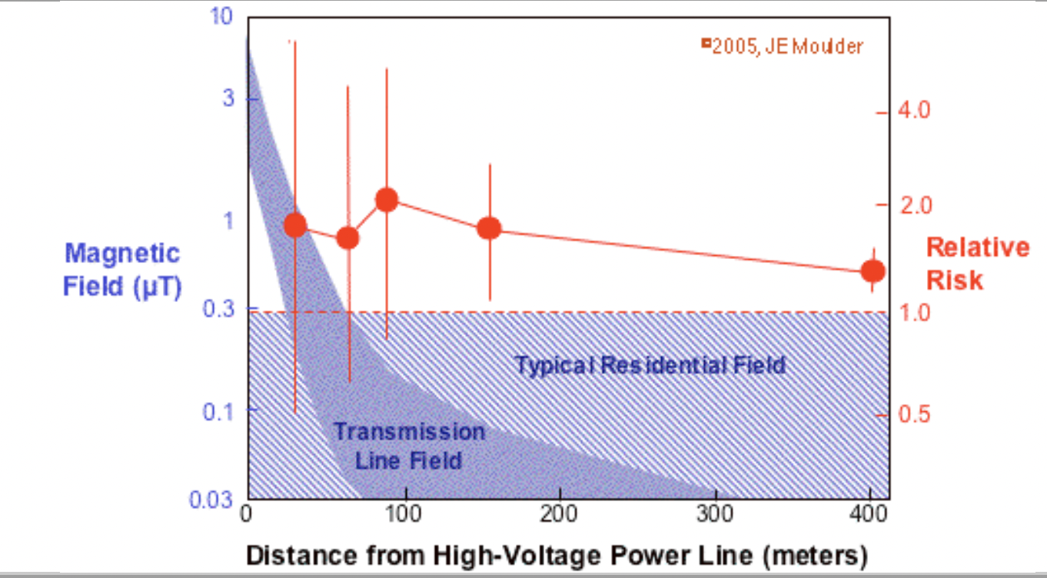
2000’s
More studies, more confusion (e.g., Draper)
Notes:
“May be due to other etiologies” You think so? ;-)

Slide 44
ICNIRP 2010

Slide 45
ICNIRP, Rational for Change
“The reference levels in the present guidelines are less restrictive than those in the 1998 guidelines. This reflects advances in dosimetry showing that the earlier values were more conservative than necessary, while still ensuring compliance with the basic restrictions.”
Source: ICNIRP. Health Physics (2010), https://www.icnirp.org/cms/upload/publications/ICNIRPLFgdl.pdf
Notes:
Interpretation:
Basic restrictions are about induced current density in the central nervous system (CNS).
These currents are theoretical calculations of how an external ELF magnetic field induces small circulating currents in tissue, particularly in the brain and spinal cord.
At very high fields (lab studies, animals, or MRI-range exposure):
Phosphenes (visual flicker) occur at ~2,000–5,000 µT (20,000–50,000 mG).
Nerve or muscle stimulation may occur at ~10,000–100,000 µT (100,000–1,000,000 mG).
Tingling/twitching and other excitability effects are reported in controlled settings.
No evidence of seizures in humans at ELF frequencies; thresholds are based on avoiding stimulation effects.
Reference levels were increased in 2010 because improved models showed the 1998 conversion was overly conservative, while still keeping induced CNS currents far below thresholds for these acute effects.
Source: ICNIRP (2010), Health Physics, 99(6), pp. 826–827. https://www.icnirp.org/cms/upload/publications/ICNIRPLFgdl.pdf

Slide 46
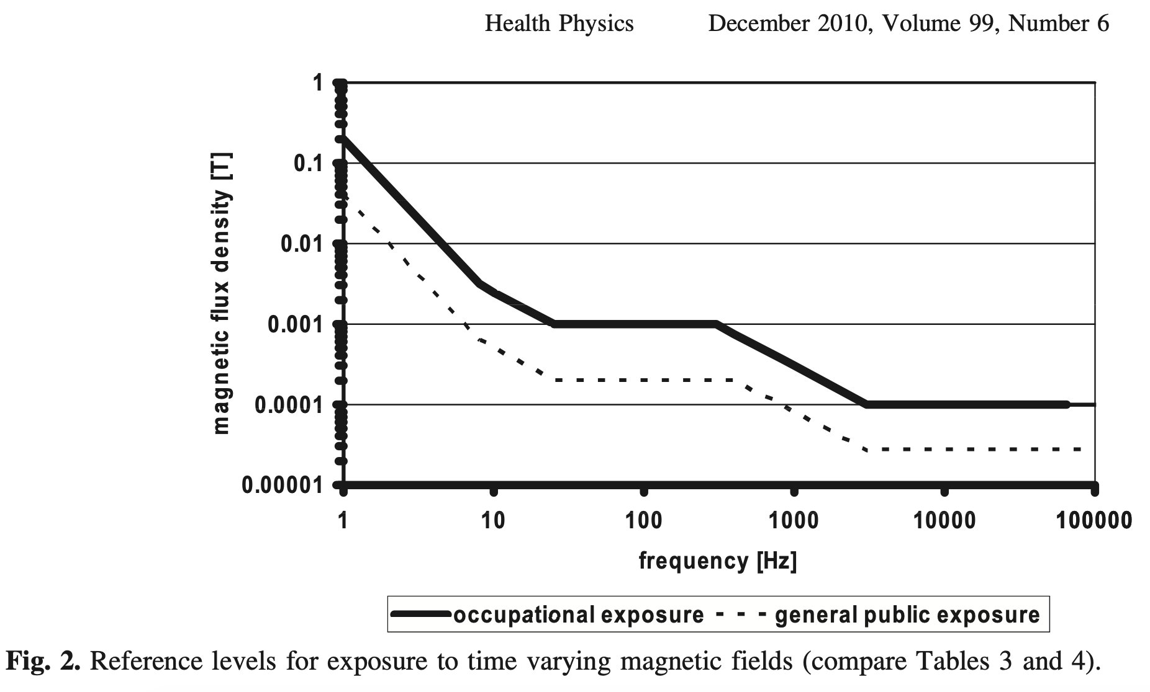
ICNIRP 2010
Notes:
ICNIRP 2010 Public B Field Limits
Table 4 (p. 827): Reference levels for general public exposure.
Frequency range 25–400 Hz: B = 200 µT (2,000 mG).
Applies equally at 50 Hz and 60 Hz.
Occupational: 1,000 µT (10,000 mG).
*Source: ICNIRP (2010), Guidelines for limiting exposure to time-varying electric and magnetic fields (1 Hz–100 kHz), Health Physics, 99(6), 818–836, p. 827. https://www.icnirp.org/cms/upload/publications/ICNIRPLFgdl.pdf
Occupational: 1 mT = 1000 µT = 10,000 mG
General public: 0.2 mT = 200 µT = 2,000 mG

Slide 47
ICNIRP 2010, Magnetic Field Limits
200 µT (2,000 mG) at 60 Hz
1000 µT (10,000 mG) at 60 Hz
Notes:
ICNIRP 2010 Public B Field Limits
Table 4 (p. 827): Reference levels for general public exposure.
Frequency range 25–400 Hz: B = 200 µT (2,000 mG).
Applies equally at 50 Hz and 60 Hz.
Occupational: 1,000 µT (10,000 mG).
*Source: ICNIRP (2010), Guidelines for limiting exposure to time-varying electric and magnetic fields (1 Hz–100 kHz), Health Physics, 99(6), 818–836, p. 827. https://www.icnirp.org/cms/upload/publications/ICNIRPLFgdl.pdf
Occupational: 1 mT = 1000 µT = 10,000 mG
General public: 0.2 mT = 200 µT = 2,000 mG

Slide 48
Exposure Guidelines at 60 Hz
Organization | Guideline | Magnetic Field (B) | Electric Field (E)
ICNIRP | 1998 | 83 µT (830 mG) | 4.2 kV/m
ICNIRP | 2010 | 200 µT (2,000 mG) | 4.2 kV/m
IEEE | 2019 | 904 µT (9,040 mG) | 5 kV/m
Notes:
Sources
ICNIRP (2010): https://www.icnirp.org/cms/upload/publications/ICNIRPLFgdl.pdf
IEEE C95.1-2019: https://standards.ieee.org/standard/C95_1-2019.html
ICNIRP 2010 Public B Field Limits
Table 4 (p. 827): Reference levels for general public exposure.
Frequency range 25–400 Hz: B = 200 µT (2,000 mG).
Applies equally at 50 Hz and 60 Hz.
Occupational: 1,000 µT (10,000 mG).
*Source: ICNIRP (2010), Guidelines for limiting exposure to time-varying electric and magnetic fields (1 Hz–100 kHz), Health Physics, 99(6), 818–836, p. 827. https://www.icnirp.org/cms/upload/publications/ICNIRPLFgdl.pdf
Occupational: 1 mT = 1000 µT = 10,000 mG
General public: 0.2 mT = 200 µT = 2,000 mG

Slide 49
ICNIRP 2010, Magnetic Field Limits
Critical response by ICNIRP to health community concerning leukemia:
“…if the relationship is not causal, then no benefit to health will accrue from reducing exposure.”
Source: ICNIRP. Health Physics (2010), https://www.icnirp.org/cms/upload/publications/ICNIRPLFgdl.pdf
Notes:
The full quote:
“Chronic effects.
“The literature on chronic effects of
low frequency fields has been evaluated in detail by
individual scientists and scientific panels. WHO’s cancer
research institute, IARC (International Agency for Research
on Cancer), evaluated low frequency magnetic
fields in 2002 and classified them in category 2 B, which
translates to “possibly carcinogenic to humans.” The
basis for this classification was the epidemiologic results
on childhood leukemia.
“It is the view of ICNIRP that the currently existing
scientific evidence that prolonged exposure to low frequency
magnetic fields is causally related with an increased
risk of childhood leukemia is too weak to form
the basis for exposure guidelines. In particular, if the
relationship is not causal, then no benefit to health will
accrue from reducing exposure.”
Source: ICNIRP (2010), Health Physics, 99(6), pp. 826–827. https://www.icnirp.org/cms/upload/publications/ICNIRPLFgdl.pdf

Slide 50
2010’s and 2020’s
Dwindling Findings

Slide 51
Kheifets et al, An Evolution
2010 study Not Significant (NS). But claimed "In line with previous analyses showing an association"
2017 study NS. But claimed "Could be viewed as consistent with previous findings of increased risk"
2022 pooled study; NS: Finally relented. "Not in line with previous analysis…could be due to a disappearing effect.”

Slide 52

NCI (Fact Sheet, 2022, accessed 2025):
"No mechanism by which ELF-EMFs … could cause cancer has been identified. Unlike high-energy (ionizing) radiation, EMFs in the non-ionizing part of the electromagnetic spectrum cannot damage DNA or cells directly."
"Studies of animals have not provided any indications that exposure to ELF-EMFs is associated with cancer."
Notes:
Sources:
NCI EMF Fact Sheet (reviewed October 2022, accessed October 2025): https://www.cancer.gov/about-cancer/causes-prevention/risk/radiation/electromagnetic-fields-fact-sheet

Slide 53
Brabant 2022, Review and Meta-analysis
Review and analysis of 38 studies (1979–2020)
21 entered the main ("global") meta-analysis.
Finding | Pooled OR (95% CI)
Main pooled analysis | 1.26 (1.06–1.49)
> 0.4 µT exposure group | 1.37 (1.05–1.80)
“Our global meta-analysis indicates a significant association between ELF-MF and childhood leukemia.”
Notes:
From a WHO Collaborating Center (University of Liege)

Slide 54
Brabant 2022 – But wait!
Chance:
Published protocol “planned to restrict…meta-analysis to children under the age of 15.”
The results pre-planned finding were not significant: 1.13 (95% CI 0.92–1.39; p=0.23)

Slide 55
Brabant 2022 – Worse Still
Selection bias:
Brabant selectively excluded parts of four large, null studies from the global meta-analysis.
Temporal bias:
Studies before 2000: OR 1.51 (1.26–1.80)
Studies after 2000 not significant: 1.04 (0.84–1.29).

Slide 56
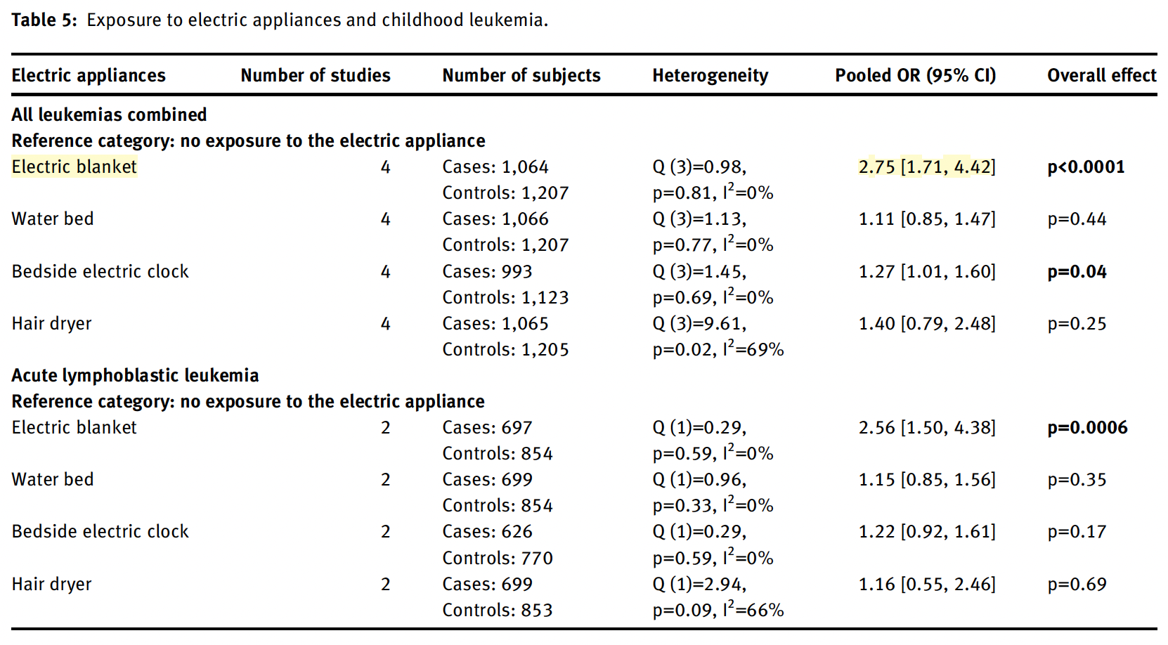
Brabant 2022 – Even Worse
Confounding:

Slide 57
Brabant 2022 – Even Worse
Confounding:

Slide 58
Take Home
Null results, or
Chance
bias
Confounding
The totality of modern evidence aligns with no causal link between ELF-MF and childhood leukemia.

Slide 59

Grade 2B still or no?
Surely now the IARC (WHO) will change classification?

Slide 60
IARC – Key Documents to Know
2002
2024

Slide 61
Notes:
Classification basis: Group 2B classification driven by epidemiologic association with childhood leukaemia, not established causation
Supporting evidence: Based on pooled analyses:
Ahlbom et al. (2000): twofold increased risk (OR 2.00) at exposures ≥0.4 µT (≥4 mG)
Greenland et al. (2000): OR 1.7 at exposures ≥0.3 µT (≥3 mG)
Both studies cited in IARC Vol. 80, p. 338
Current status: 2024 IARC Advisory Group did not recommend re-evaluation through 2029, stating "Existing evidence does not appear to support a change in classification”
Sources:
IARC Monograph Vol. 80 (2002) p. 338 https://www.ncbi.nlm.nih.gov/books/NBK390729/
IARC Advisory Group Report (2024): https://monographs.iarc.who.int/wp-content/uploads/2024/11/AGP_Report_2025-2029.pdf
“Existing evidence does not appear to support a change in classification” (p.7)
Summary:
“There are only a few new scientific papers since the publication of IARC Monographs Volume 80, with weak exposure assessment and showing a weaker association. Overall, evidence remains consistent in showing an association between exposure to ELF magnetic fields and childhood leukaemia, based largely on studies evaluated in the previous monograph. New initiation–promotion studies show tumour-promoting activity of ELF-MF. Since the previous evaluation, new mechanistic studies related to the KCs in experimental systems, and new studies evaluating the genotoxicity of ELF-MF in exposed humans, became available. However, the findings across all systems remain inconsistent. Overall, the available information does not support a re-evaluation. The Advisory Group therefore considered that an IARC Monographs evaluation of ELF-MF is unwarranted at present.
Recommendation: No priority” page 171

Slide 62
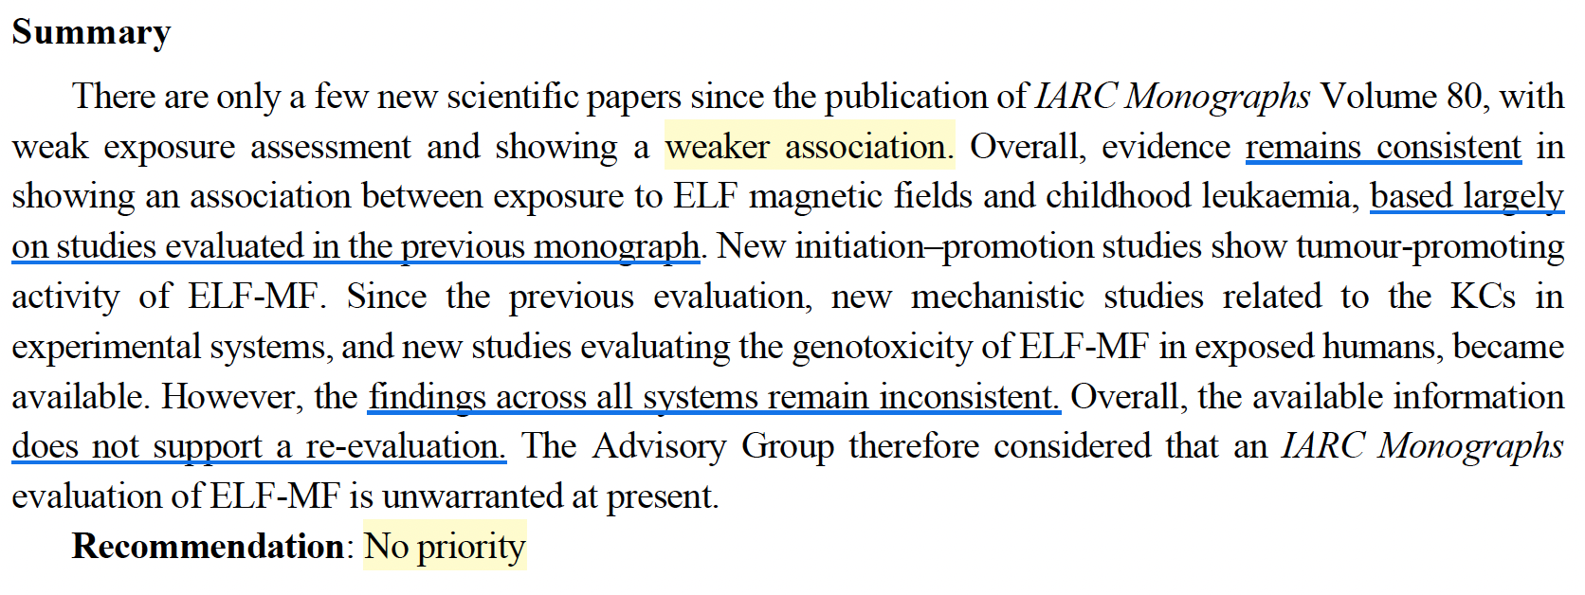
IARC 2024
IARC Advisory Group Report, 2024, p.171
Notes:
Classification basis: Group 2B classification driven by epidemiologic association with childhood leukaemia, not established causation
Supporting evidence: Based on pooled analyses:
Ahlbom et al. (2000): twofold increased risk (OR 2.00) at exposures ≥0.4 µT (≥4 mG)
Greenland et al. (2000): OR 1.7 at exposures ≥0.3 µT (≥3 mG)
Both studies cited in IARC Vol. 80, p. 338
Current status: 2024 IARC Advisory Group did not recommend re-evaluation through 2029, stating "Existing evidence does not appear to support a change in classification”
Sources:
IARC Monograph Vol. 80 (2002) p. 338 https://www.ncbi.nlm.nih.gov/books/NBK390729/
IARC Advisory Group Report (2024): https://monographs.iarc.who.int/wp-content/uploads/2024/11/AGP_Report_2025-2029.pdf
“Existing evidence does not appear to support a change in classification” (p.7)
Summary:
“There are only a few new scientific papers since the publication of IARC Monographs Volume 80, with weak exposure assessment and showing a weaker association. Overall, evidence remains consistent in showing an association between exposure to ELF magnetic fields and childhood leukaemia, based largely on studies evaluated in the previous monograph. New initiation–promotion studies show tumour-promoting activity of ELF-MF. Since the previous evaluation, new mechanistic studies related to the KCs in experimental systems, and new studies evaluating the genotoxicity of ELF-MF in exposed humans, became available. However, the findings across all systems remain inconsistent. Overall, the available information does not support a re-evaluation. The Advisory Group therefore considered that an IARC Monographs evaluation of ELF-MF is unwarranted at present.
Recommendation: No priority” page 171

Slide 63
Institutional Inertia
IARC Advisory Group Report, 2024, p.171
IARC Advisory Group Report, 2024, p.171
Notes:
Classification basis: Group 2B classification driven by epidemiologic association with childhood leukaemia, not established causation
Supporting evidence: Based on pooled analyses:
Ahlbom et al. (2000): twofold increased risk (OR 2.00) at exposures ≥0.4 µT (≥4 mG)
Greenland et al. (2000): OR 1.7 at exposures ≥0.3 µT (≥3 mG)
Both studies cited in IARC Vol. 80, p. 338
Current status: 2024 IARC Advisory Group did not recommend re-evaluation through 2029, stating "Existing evidence does not appear to support a change in classification”
Sources:
IARC Monograph Vol. 80 (2002) p. 338 https://www.ncbi.nlm.nih.gov/books/NBK390729/
IARC Advisory Group Report (2024): https://monographs.iarc.who.int/wp-content/uploads/2024/11/AGP_Report_2025-2029.pdf
“Existing evidence does not appear to support a change in classification” (p.7)
Summary:
“There are only a few new scientific papers since the publication of IARC Monographs Volume 80, with weak exposure assessment and showing a weaker association. Overall, evidence remains consistent in showing an association between exposure to ELF magnetic fields and childhood leukaemia, based largely on studies evaluated in the previous monograph. New initiation–promotion studies show tumour-promoting activity of ELF-MF. Since the previous evaluation, new mechanistic studies related to the KCs in experimental systems, and new studies evaluating the genotoxicity of ELF-MF in exposed humans, became available. However, the findings across all systems remain inconsistent. Overall, the available information does not support a re-evaluation. The Advisory Group therefore considered that an IARC Monographs evaluation of ELF-MF is unwarranted at present.
Recommendation: No priority” page 171

Slide 65
WHO
World Health Organization
United Nations’ agency for public health
"Health is a state of complete physical, mental and social well-being and not merely the absence of disease or infirmity."
Issue recommendations
Notes:
WHO role: Issues scientific assessments and policy recommendations but has no regulatory authority
EMF publications: EHC 238 (2007) on Extremely Low Frequency Fields
Fact Sheets on electromagnetic fields
Sources:
WHO Constitution (1946): https://www.who.int/about/governance/constitution
WHO EMF resources (accessed 2025): https://www.who.int/teams/environment-climate-change-and-health/radiation-and-health/non-ionizing/emf

Slide 66
WHO
Environmental Health Criteria 238 (EHC 238)
“Extremely Low Frequency Fields”
>500 page document
Published 2007
Remains WHO’s most recent document on EMF
Notes:
EHC = Environmental Heath Criteria
WHO EHC 238 (2007) is the authoritative review on ELF fields. It endorses ICNIRP guidelines and concludes that the evidence for childhood leukaemia is too weak to establish causation. WHO recommends precautionary approaches for managing uncertainty but notes that arbitrary low exposure limits are not warranted.
Source: WHO EHC 238 (2007): https://www.icnirp.org/cms/upload/publications/EHC238ELF.pdf

Slide 67
WHO (EHC 238)
ACUTE EFFECTS
"Acute biological effects have been established….”
"Compliance with these guidelines [ICNIRP 1998; IEEE 2002] provides adequate protection for acute effects."
CHRONIC EFFECTS
Magnetic fields:
"There is limited evidence for childhood leukaemia; inadequate evidence for other outcomes."
Notes:
WHO EHC 238 (2007) is the authoritative review on ELF fields. It endorses ICNIRP guidelines and concludes that the evidence for childhood leukaemia is too weak to establish causation. WHO recommends precautionary approaches for managing uncertainty but notes that arbitrary low exposure limits are not warranted.
Source: WHO EHC 238 (2007): https://www.icnirp.org/cms/upload/publications/EHC238ELF.pdf

Slide 68
WHO (EHC 238) – Chronic Effects
“…exposure limits based upon epidemiological evidence are not recommended.”
…Such practice undermines the scientific foundation on which the limits are based and is likely to be an expensive and not necessarily effective way of providing protection.”
Notes:
WHO EHC 238 (2007) is the authoritative review on ELF fields. It endorses ICNIRP guidelines and concludes that the evidence for childhood leukaemia is too weak to establish causation. WHO recommends precautionary approaches for managing uncertainty but notes that arbitrary low exposure limits are not warranted.
Source: WHO EHC 238 (2007): https://www.icnirp.org/cms/upload/publications/EHC238ELF.pdf
Page 257:
In summary, taking this information into consideration, the overall
IARC (2002) evaluation for the carcinogenicity of EMFs was:
• There is limited evidence in humans for the carcinogenicity of
extremely low-frequency magnetic fields in relation to childhood
leukaemia.
• There is inadequate evidence in humans for the carcinogenicity of
extremely low-frequency magnetic fields in relation to all other
cancers.
• There is inadequate evidence in humans for the carcinogenicity of
static electric or magnetic fields and extremely low-frequency
electric fields.
• There is inadequate evidence in experimental animals for the
carcinogenicity of extremely low-frequency magnetic fields.
• No data relevant to the carcinogenicity of extremely low-frequency
electric fields in experimental animals were available.
Leading to the conclusion that:
• Extremely low-frequency magnetic fields are possibly carcinogenic
to humans (Group 2B).
• …extremely low-frequency electric fields are not classifiable as to
their carcinogenicity to humans (Group 3).
Page 12 quote:
Protective measures
It is essential that exposure limits be implemented in order to protect
against the established adverse effects of exposure to ELF electric and
magnetic fields. These exposure limits should be based on a thorough examination
of all the relevant scientific evidence.
Only the acute effects have been established and there are two international
exposure limit guidelines (ICNIRP, 1998a; IEEE, 2002) designed to
protect against these effects.
As well as these established acute effects, there are uncertainties
about the existence of chronic effects, because of the limited evidence for a
link between exposure to ELF magnetic fields and childhood leukaemia.
Therefore the use of precautionary approaches is warranted. However, it is
not recommended that the limit values in exposure guidelines be reduced to
some arbitrary level in the name of precaution. Such practice undermines the
scientific foundation on which the limits are based and is likely to be an
expensive and not necessarily effective way of providing protection.”

Slide 69
WHO “Exposure Backgrounder”
"Given the weakness of the evidence for a link between exposure to ELF magnetic fields and childhood leukaemia, the benefits of exposure reduction on health are unclear.”
WHO ELF Exposure Backgrounder (2007, accessed October 2025):
https://www.who.int/teams/environment-climate-change-and-health/radiation-and-health/non-ionizing/exposure
Notes:
WHO ELF Exposure Backgrounder (2007, accessed October 2025): https://www.who.int/teams/environment-climate-change-and-health/radiation-and-health/non-ionizing/exposure
WHO Fact Sheet 322 (2007)
WHO EHC 238 (2007): https://www.icnirp.org/cms/upload/publications/EHC238ELF.pdf
Page 335:
12.6 Conclusions
“Acute biological effects have been established for exposure to ELF
electric and magnetic fields in the frequency range up to 100 kHz that may
have adverse consequences on health. Therefore, exposure limits are needed.
International guidelines exist that have addressed this issue. Compliance
with these guidelines provides adequate protection.
Consistent epidemiological evidence suggests that chronic low-
intensity ELF magnetic field exposure is associated with an increased risk of
childhood leukaemia. However, the evidence for a causal relationship is limited, therefore exposure limits based upon epidemiological evidence are not
recommended, but some precautionary measures are warranted.

Slide 70
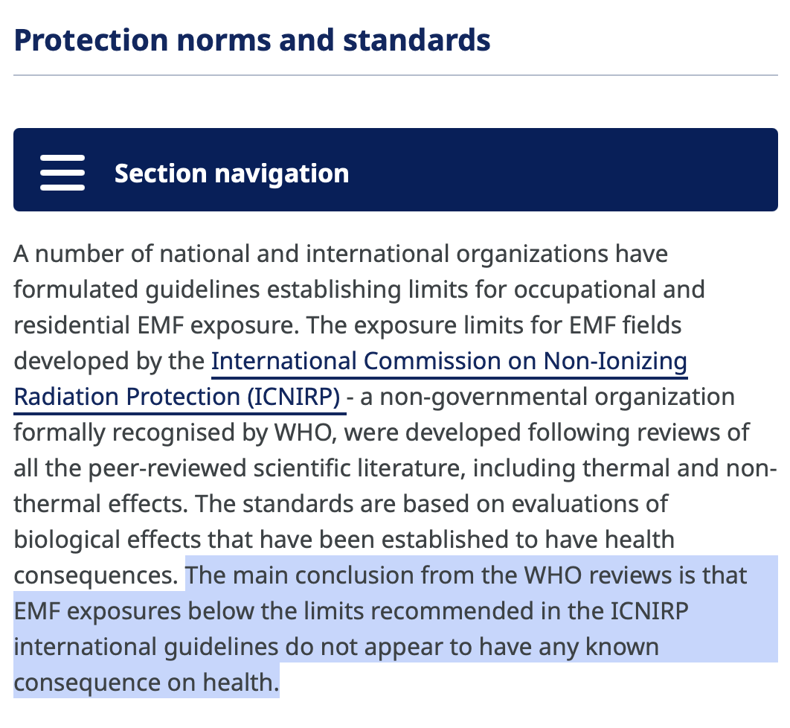
WHO “Protection Norms and Standards”
Source: https://www.who.int/teams/environment-climate-change-and-health/radiation-and-health/protection-norms
accessed Oct 2025
Notes:
Source: https://www.who.int/teams/environment-climate-change-and-health/radiation-and-health/protection-norms
Last accessed Oct 2025

Slide 71

WHO “Protection Norms and Standards”
Source: https://www.who.int/teams/environment-climate-change-and-health/radiation-and-health/protection-norms
accessed Oct 2025
Notes:
Source: https://www.who.int/teams/environment-climate-change-and-health/radiation-and-health/protection-norms
Last accessed Oct 2025

Slide 72
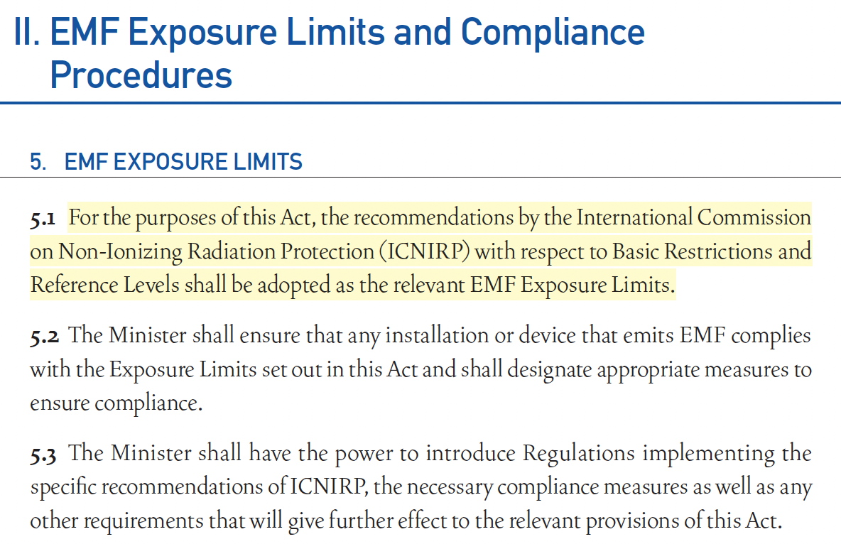
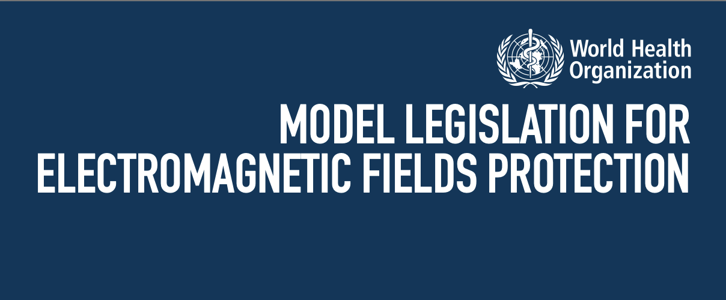
WHO – Model Legislation
2006, last accessed October 2025
Notes:
Model Legislation for EMF Protection (WHO 2006)
https://iris.who.int/server/api/core/bitstreams/4ba3c686-5f9c-40e3-a787-ad27521f2ed8/content
ii. EMF Exposure Limits and Compliance
Procedures
5. EMF Exposure Limits
5.1 For the purposes of this Act, the recommendations by the International Commission on Non-Ionizing Radiation Protection (ICNIRP) with respect to Basic Restrictions and Reference Levels shall be adopted as the relevant EMF Exposure Limits.
Yes, this is a 2006 document, but it’s maintained on WHO webpage which says the following, that’s dated 2025
“Overview
“In response to requests from Member States, the International EMF Project has developed a Model Legislation that provides the legal framework for implementing protection programmes against non-ionizing radiation.
“This Model Legislation follows the widely accepted practice among lawmakers of having an enabling Act that permits the responsible Minister to subsequently issue Regulations, Statutory Orders or Ordinances, as appropriate, to deal with specific areas of concern. It comprises a Model Act, a Model Regulation and an Explanatory Memorandum describing the approach to the Act and its Regulations.”
https://www.who.int/publications/i/item/9241594322
© 2025 WHO [accessed 10/5/25]

Slide 75
Summarize
IARC (WHO) – Group 2B carcinogen
WHO & Most of EU – Follow ICNIRP guidelines
NIH – weak findings; no mechanism
Research – null results for decades; chance, bias, confounding

Slide 76
Do transmission lines cause cancer?
No
No, but in yellow

Slide 77

“It is sad that hundreds of millions of dollars have gone into studies that never had much promise of finding a way to prevent the tragedy of cancer in children”
Edward Campion, MD.
Editorial: Power lines, cancer, and fear. The New England Journal of Medicine. 1997.

Slide 78
Bio Break

Slide 80
Electromagnetic Interference (EMI)

Slide 81
Non-Cardiac Devices EMI from Transmission Line
Drug Delivery Devices
e.g., Insulin Pumps
Sense chemical signals
Shielded electronics
not a concern
Neurostimulators
e.g., Deep Brain Stimulators (DBS)
Stimulation leads, not sensing leads
Shielded electronics
not a concern
Cochlear Implants
Receive RF signals from external processor
Sense mechanical signals
No recorded cases of harm from power system fields
not a concern
Notes:
EMF confuses sensing inside the body, which is why it theoretically was concern for defib etc. And not for non-bio sensing devices
Non-cardiac devices (insulin pumps, DBS, cochlear implants) are not susceptible to power-line frequency electromagnetic interference. Power-line EMI concerns apply specifically to cardiac devices (pacemakers, ICDs) that sense minute electrical signals.
UK Medicines and Healthcare Products Regulatory Agency. Interference with hearing aids and cochlear implants. EMFs.info; accessed October 2025. https://www.emfs.info/effects/medical-devices/cochlear/

Slide 82
Pacemaker Lead Configuration
Unipolar Leads
One electrode in heart, one on device case
Large sensing loop
10 x more susceptible to electromagnetic interference
Rarely implanted since 1990s
Obsolete
Bipolar Leads
Both electrodes close together near heart (2 cm apart)
Small sensing loop
Highly resistant to electromagnetic interference
Standard practice since 1990s

Slide 83
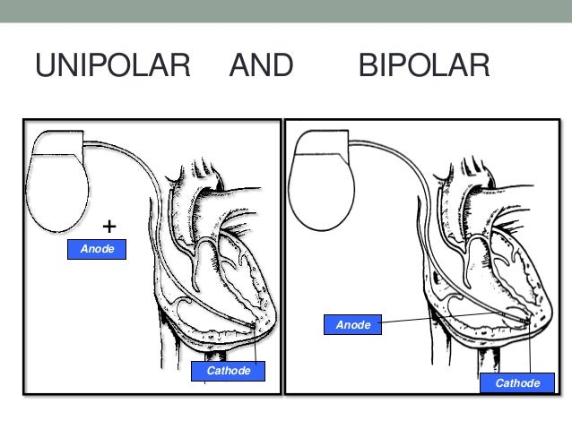
Notes:
Bipolar became standard in 1990s. All new pacing leads implanted today are bipolar. Bipolar configuration reduces induced voltages by factor of 10 compared to unipolar.
Gercek C, Kourtiche D, Nadi M, et al. Computation of Pacemakers Immunity to 50 Hz Electric Field: Induced Voltages 10 Times Greater in Unipolar Than in Bipolar Detection Mode. Bioengineering (Basel). 2017;4(1):19.
https://pmc.ncbi.nlm.nih.gov/articles/PMC5590432/
"99% of the implanted pacing leads in the USA and Europe" are bipolar configuration in right atrium or right ventricle.

Slide 85

EMI Real-World Study Tiikkaja M, et al. Safety & Health at Work. 2013.
Method:
11 bipolar pacemakers
walked 10 minutes under 400 kV transmission line
*Field levels: <3 µT (<30 mG) magnetic field, <4 kV/m electric field
ECG real time to evaluate
Findings:
No EMI
*“We were unable to measure the field intensities under the transmission lines because of the freezing weather of the day with temperature below the operation temperature of the meters.”
Notes:
Tiikkaja M, Aro AL, Alanko T, et al. Testing of common electromagnetic environments for risk of interference with cardiac pacemaker function. Saf Health Work. 2013;4(3):156-159.
https://pmc.ncbi.nlm.nih.gov/articles/PMC3791084/
Same research group at Finnish Institute of Occupational Health. Real-world conditions under actual operating transmission lines (not laboratory simulation).
Study field levels: <3 µT (<30 mG) magnetic, <4 kV/m electric. These were calculated analytically from grid company voltage/current data - could not measure due to freezing weather. Field levels reported in Methods section of study.
Project comparison: This project's 765 kV line has maximum calculated exposure of 45 µT (450 mG) magnetic and 12 kV/m electric at 1 meter off ground, centerline, lines at lowest height (worst-case scenario). Project field levels are approximately 15x higher magnetic and 3x higher electric than the real-world study tested. Therefore, real-world study demonstrates safety under actual transmission lines but at lower field levels than this project.
Lab study provides critical safety margin: 220 µT (2,200 mG) tested is approximately 5 times higher than this project's worst-case exposure of 45 µT (450 mG). No interference found in bipolar pacemakers even at lab's higher exposure levels.
If asked about US vs European frequency: 60 Hz (US) vs 50 Hz (Europe) - both tested, results equivalent.
Method
Interrogated devices before event.
3-lead ECG during event
Examined ECG for aberrant heart rate or rhythm
“We were unable to measure the field intensities under the transmission lines because of the freezing weather of the day with temperature below the operation temperature of the meters.”

Slide 86
EMI: Laboratory Study Tiikkaja M, et al. Europace. 2013
Method:
11 people with bipolar pacemakers; 13 with ICDs
60 Hz sine wave @ 95 µT, 170, then 220 (2,200 mG)
Findings:
None of the bipolar pacemakers or ICDs experienced interference
Three unipolar pacemakers showed interference at highest exposures
Conclusion:
Modern bipolar pacemakers -- no interference
Unipolar devices (obsolete technology) are susceptible at high field levels
Notes:
Tiikkaja M, Aro AL, Alanko T, et al. Electromagnetic interference with cardiac pacemakers and implantable cardioverter-defibrillators from low-frequency electromagnetic fields in vivo. Europace. 2013;15(3):388-394.
https://academic.oup.com/europace/article/15/3/388/433470
Study conducted at Finnish Institute of Occupational Health. Progressive exposure design to find interference thresholds. Perpendicular orientation used in lab is worst-case for interference - represents maximum coupling. Unipolar devices rarely implanted since 1990s; approximately 99% of current pacemakers use bipolar leads. Conversion: 1 µT = 10 mG.
Manufacturers of paces in this study:
St Jude Medical (Sylmar, CA, USA)
Boston Scientific (Natick, MA, USA)
Medtronic (Minneapolis, MN, USA).

Slide 87
Guideline / Standard | Population | Magnetic Flux Density @60 Hz (B Field)
ICNIRP 1998 | General Public | 83 µT (830 mG)*
ICNIRP 2010 | General Public | 200 µT (2,000 mG)
EN 50527-1 (2010) | Workers with AIMDs | 83 µT (830 mG)
Most European countries base their limits on ICNIRP’s guidelines (see EU 1999/519/EC).
Notes:
Most European countries base their limits on ICNIRP’s recommendations (see EU 1999/519/EC). The legal framework still reflects ICNIRP 1998, while the scientific consensus has since been updated (2010 for ELF, 2020 for RF).

Slide 88
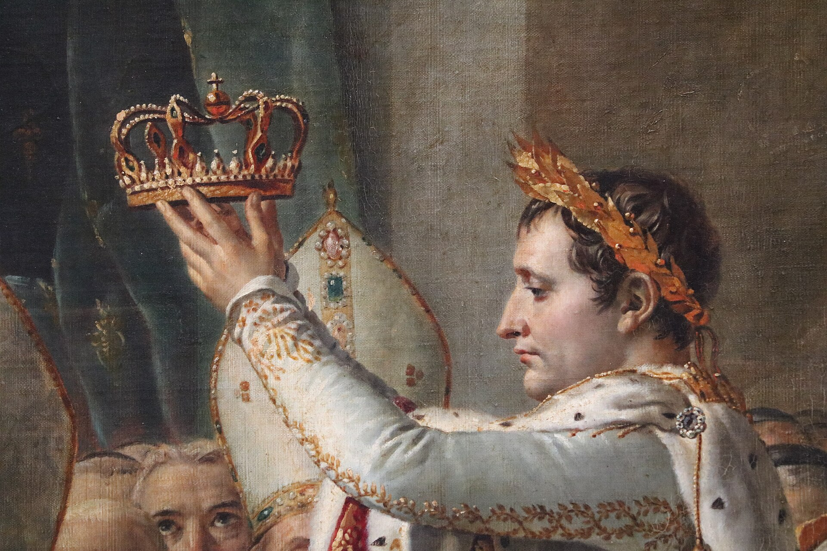
Corona discharge
Notes:
“corona effect”
Corona discharge
Corona noise

Slide 89
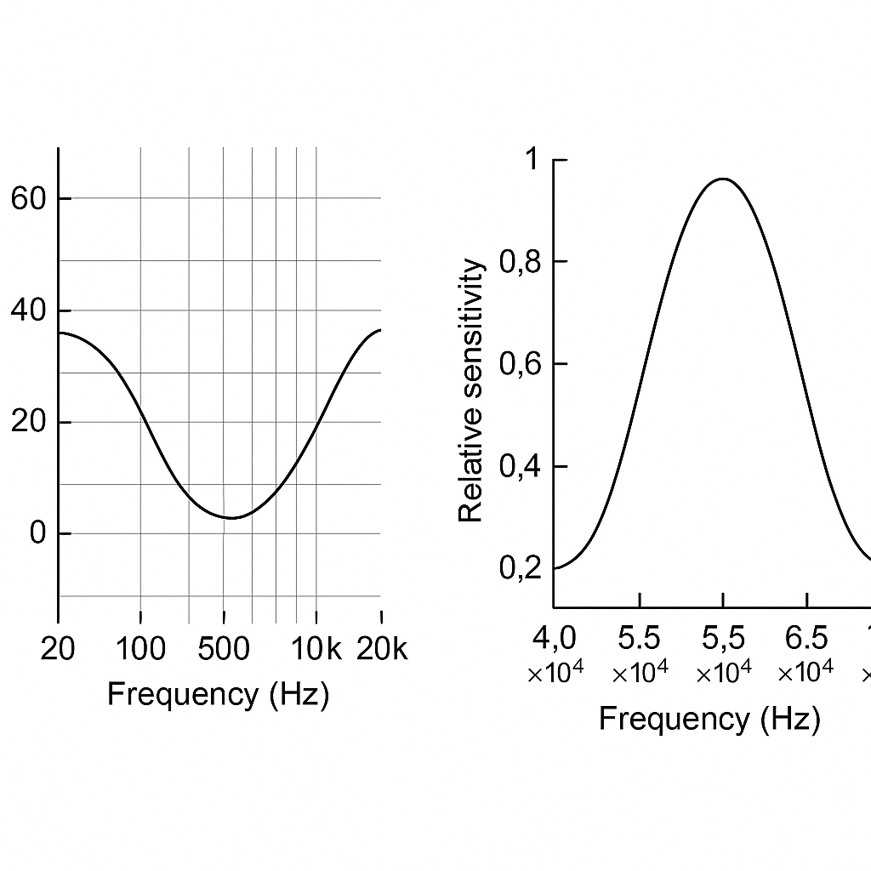
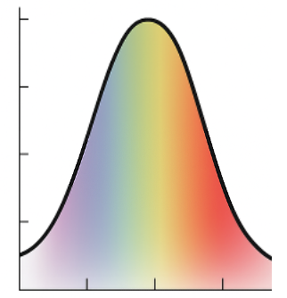
Shifting to Acoustics from EM
Ear
Eye
Notes:
Sound – mechanical disturbance in medium
Sight – EM (radiating disturbance in electrical and magnetic fields)

Slide 90
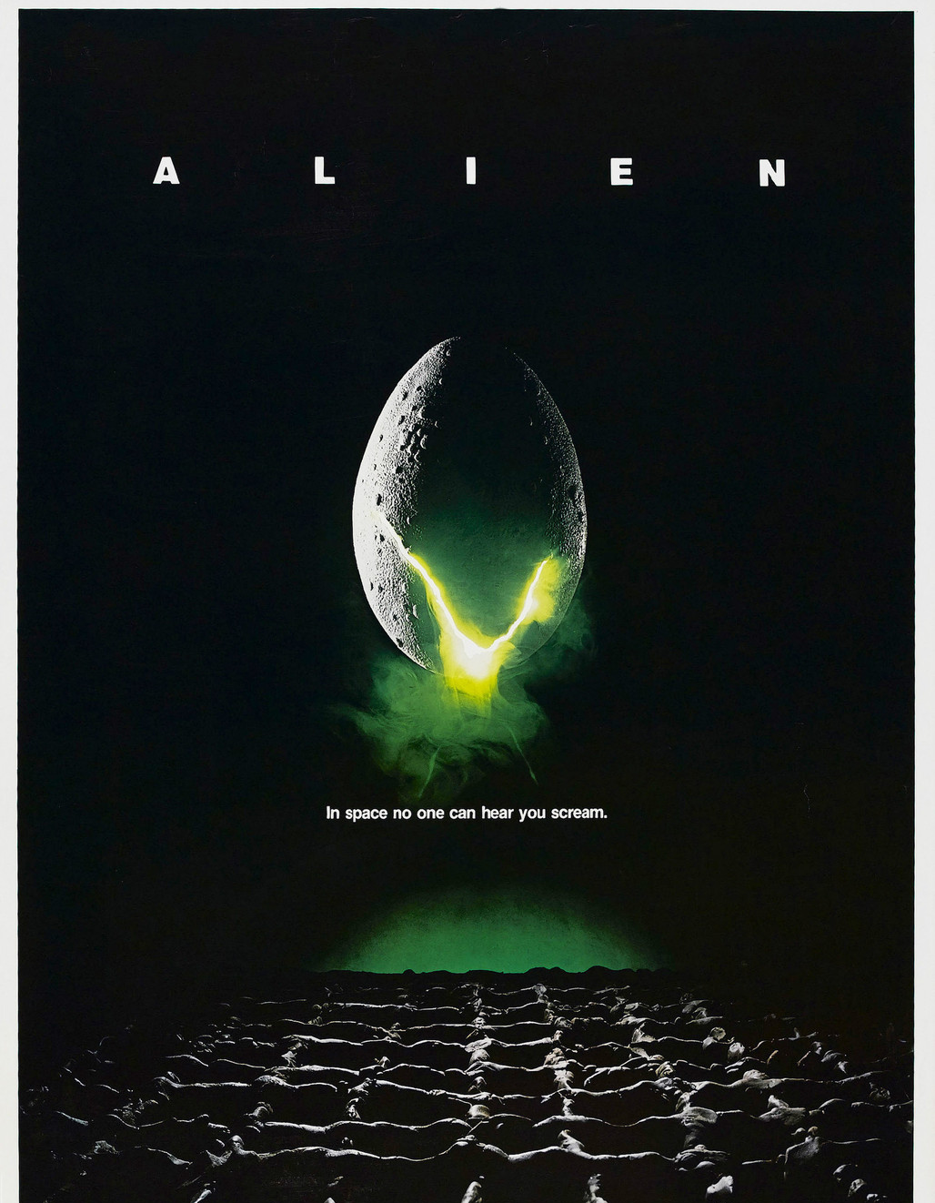
Notes:
Electromagnetism – no medium needed – it’s sself-propogating disturbances in electrical and magnetic fields
Sound – medium needed; it’s a mechanical wave (pressure changes in particles)
Speed: Sound: 343 m/s
EM: 300 million m/s
Median nerve: 60 m/s
Piano
88 keys
27.5 (bottom),
261.6 (middle C)
4186 (top)

Slide 91

Amplitude & Frequency
27.5 Hz
4186 Hz
Notes:
Electromagnetism – no medium needed – it’s sself-propogating disturbances in electrical and magnetic fields
Sound – medium needed; it’s a mechanical wave (pressure changes in particles)
Speed: Sound: 343 m/s
EM: 300 million m/s
Median nerve: 60 m/s
Piano
88 keys
27.5 (bottom),
261.6 (middle C)
4186 (top)

Slide 92
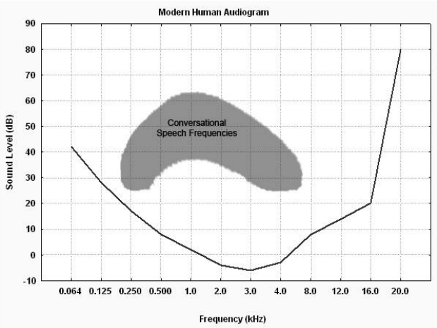

Slide 94
Corona Noise
Level:
Spectrum:
Temporal Pattern:
When it occurs:
Receiver context:
<50 dBA at ROW edge
Broadband >> tonal
Continuous (not impulsive)
Wet weather predominant
a) Outside; b) Bedroom

Slide 95
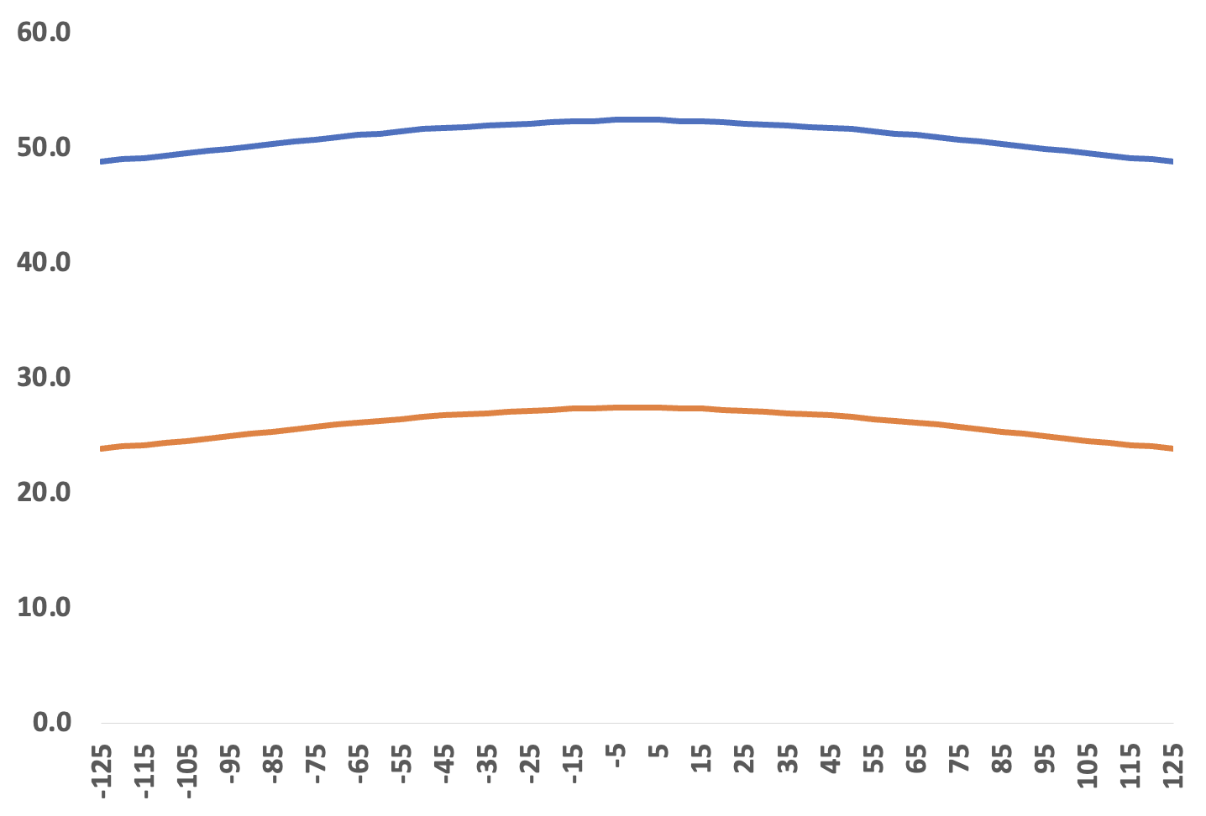
Level
Noise Level dBA (@ 1.5m above ground)
Worst case
Normal Operation
Offset Distance (feet)

Slide 96
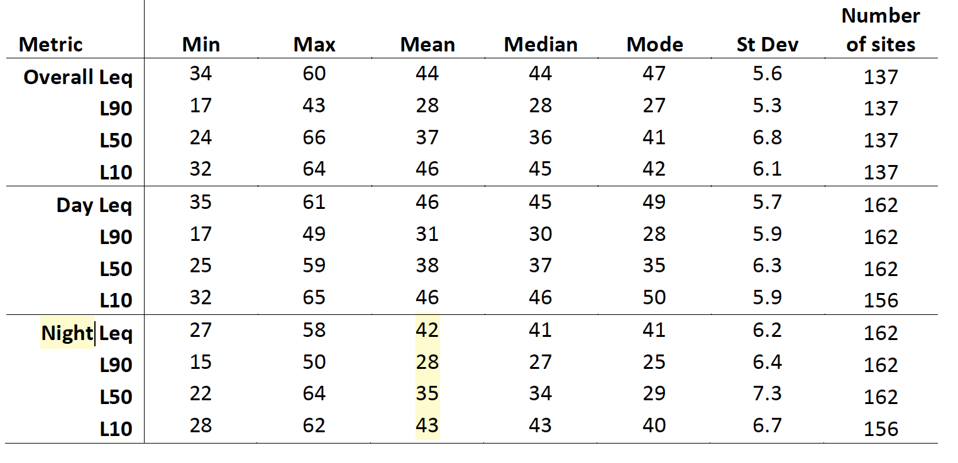
Noise in Context (Rural Background)
Kaliski K et al. Noise-Con 2023

Slide 97
Noise in Context (Rural Background Sound)
Kaliski K et al. Noise-Con 2023

Slide 98
How Loud?
But is 50 dBA corona vs 30 dBA background the right comparison?
Outdoors: during foul weather (rain and wind are noisy)
Indoors: house blocks some of noise
Notes:
Kaliski K et al. Proc Inter-Noise 2023: https://www.ingentaconnect.com/contentone/ince/incecp/2023/00000266/00000001/art00026

Slide 99
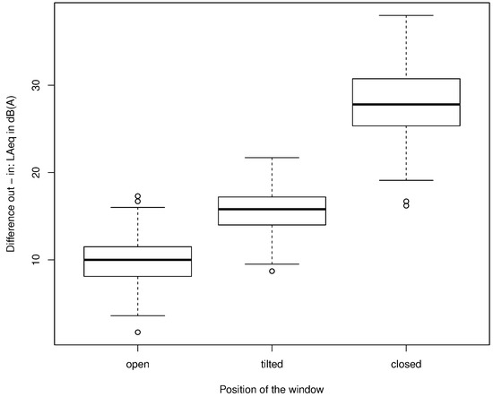
Outdoors to Indoors, Noise Changes
Typical façade attenuation:
10 dB: Windows open
15-20 dB: Partly closed
25–30 dB: Closed
Example: 50 dBA outside → 25–35 dBA inside
Locher B et al. Int J Environ Res Public Health. 2018
Notes:
WHO 2018 summarizes façade attenuation: “around 10 dB for open, 15 dB for tilted/half-open, ~25 dB for closed windows.” Citations: WHO (2018): https://iris.who.int/bitstream/handle/10665/279952/9789289053563-eng.pdf;
Locher B et al. Int J Environ Res Public Health. 2018;15(1):149: https://www.mdpi.com/1660-4601/15/1/149

Slide 100
Notes:
WHO 2018 summarizes façade attenuation: “around 10 dB for open, 15 dB for tilted/half-open, ~25 dB for closed windows.” Citations: WHO (2018): https://iris.who.int/bitstream/handle/10665/279952/9789289053563-eng.pdf;
Locher B et al. Int J Environ Res Public Health. 2018;15(1):149: https://www.mdpi.com/1660-4601/15/1/149

Slide 101
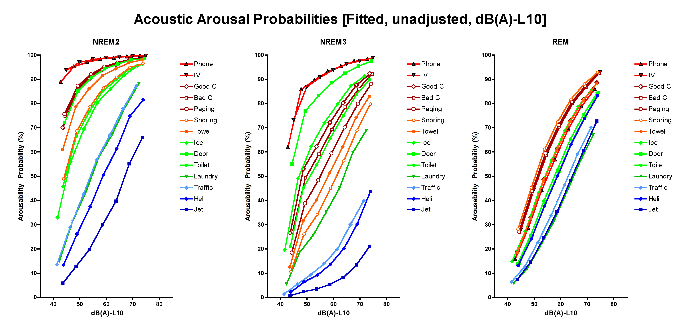
Probing sleep depth
N2
N3
R
Buxton, Ellenbogen et al, Annals of Internal Medicine, 2012
Notes:
Four points:
Louder sounds cause more disruption
Deep sleep really is deep (i.e., N3 more resistant)
Sounds cluster
REM different (this is a surprise, given the relatively active brain state, possibly that REM is internally focused, thus not keyed in on salience
Other? Pitch and other acoustic elements
When comparing noise sensitivity across sleep stage, Cox
regression yielded a Hazard Ratio of 0.54 (P,0.0001) associated with stage
N3, so-called slow-wave sleep, relative to N2. In line with previous
reports [1,8], this value indicates a suppressed hazard of disruption
in N3 compared with N2 (the probability of tolerating noise at any
loudness in N3 being roughly the square root of that in N2).
Perrin et al Clinical Neurophys
Auditory evoked potentials showing preference to one’s name in REM sleep

Slide 102
Notes:
Four points:
Louder sounds cause more disruption
Deep sleep really is deep (i.e., N3 more resistant)
Sounds cluster
REM different (this is a surprise, given the relatively active brain state, possibly that REM is internally focused, thus not keyed in on salience
Other? Pitch and other acoustic elements
When comparing noise sensitivity across sleep stage, Cox
regression yielded a Hazard Ratio of 0.54 (P,0.0001) associated with stage
N3, so-called slow-wave sleep, relative to N2. In line with previous
reports [1,8], this value indicates a suppressed hazard of disruption
in N3 compared with N2 (the probability of tolerating noise at any
loudness in N3 being roughly the square root of that in N2).
Perrin et al Clinical Neurophys
Auditory evoked potentials showing preference to one’s name in REM sleep

Slide 103
Summary: Corona Discharge Is Not a Health Issue
Corona = surface phenomenon
Main issue = noise
reducing with distance
Reduced by house
broadband >> tonal
Continuous >>>>> impulsive
Mostly in foul weather
Notes:
Context and weather are key for interpreting noise data. Use IEEE 656 for measurement; mitigate via bundling and maintenance. Position corona as a nuisance-management topic, not a health hazard.

Slide 104

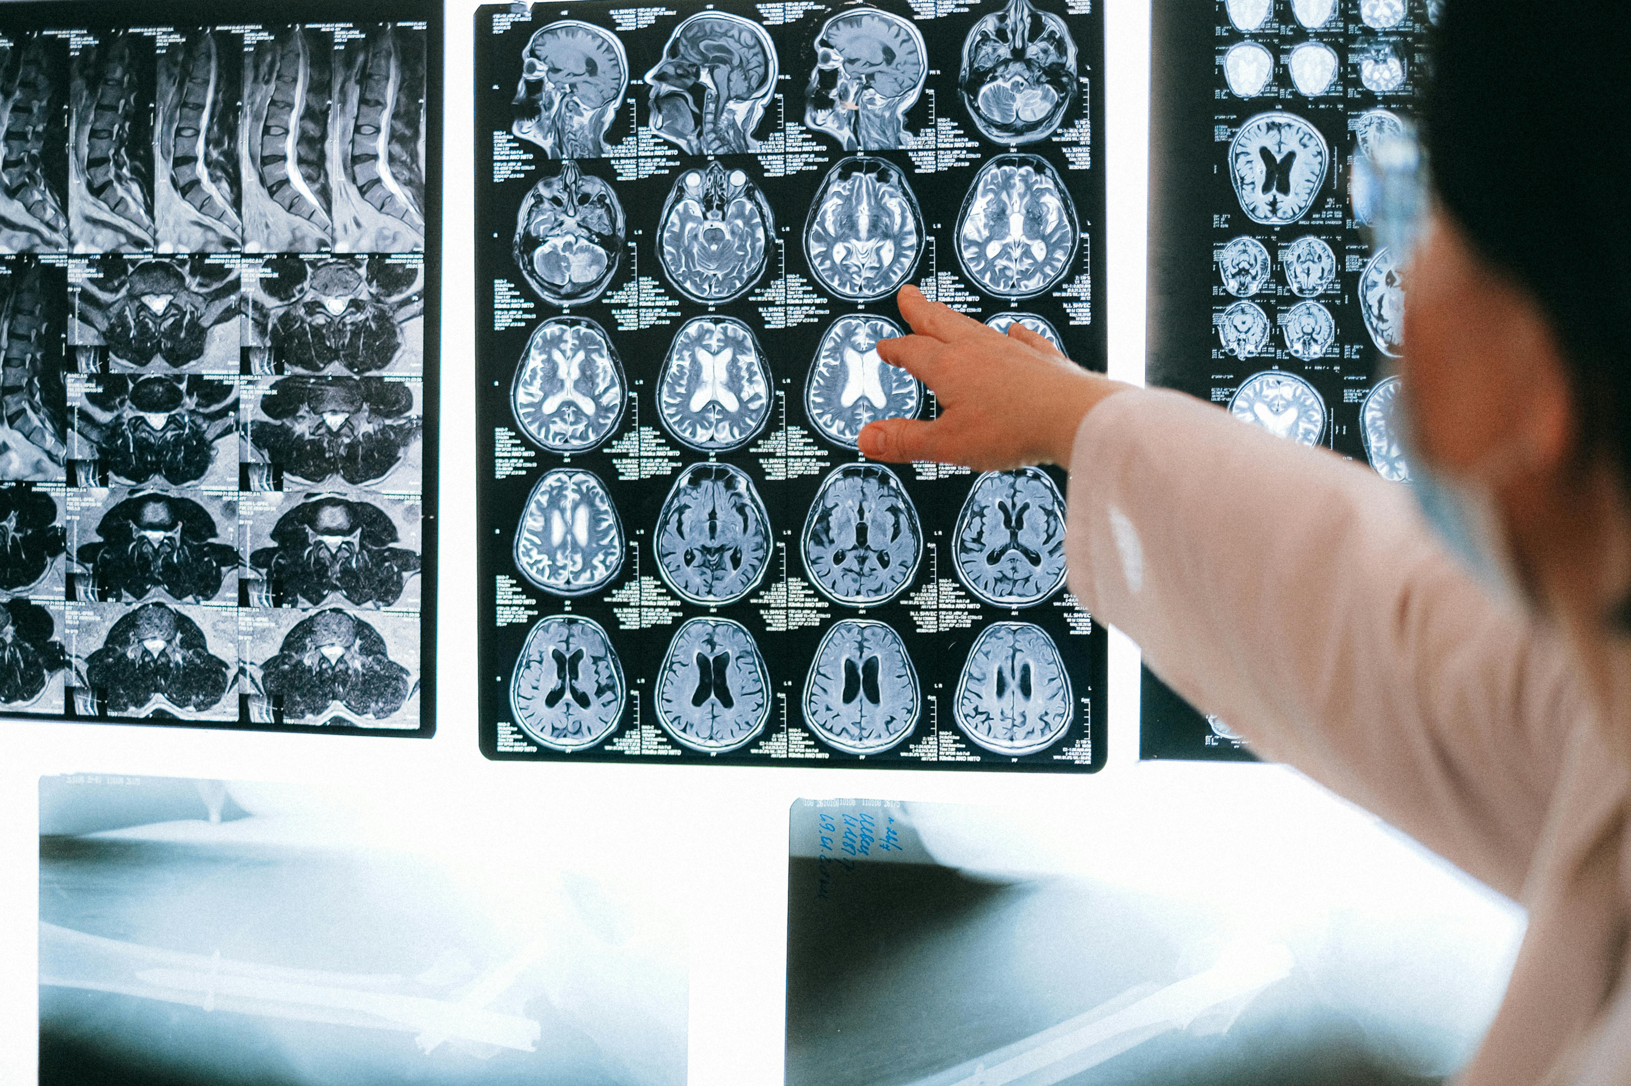
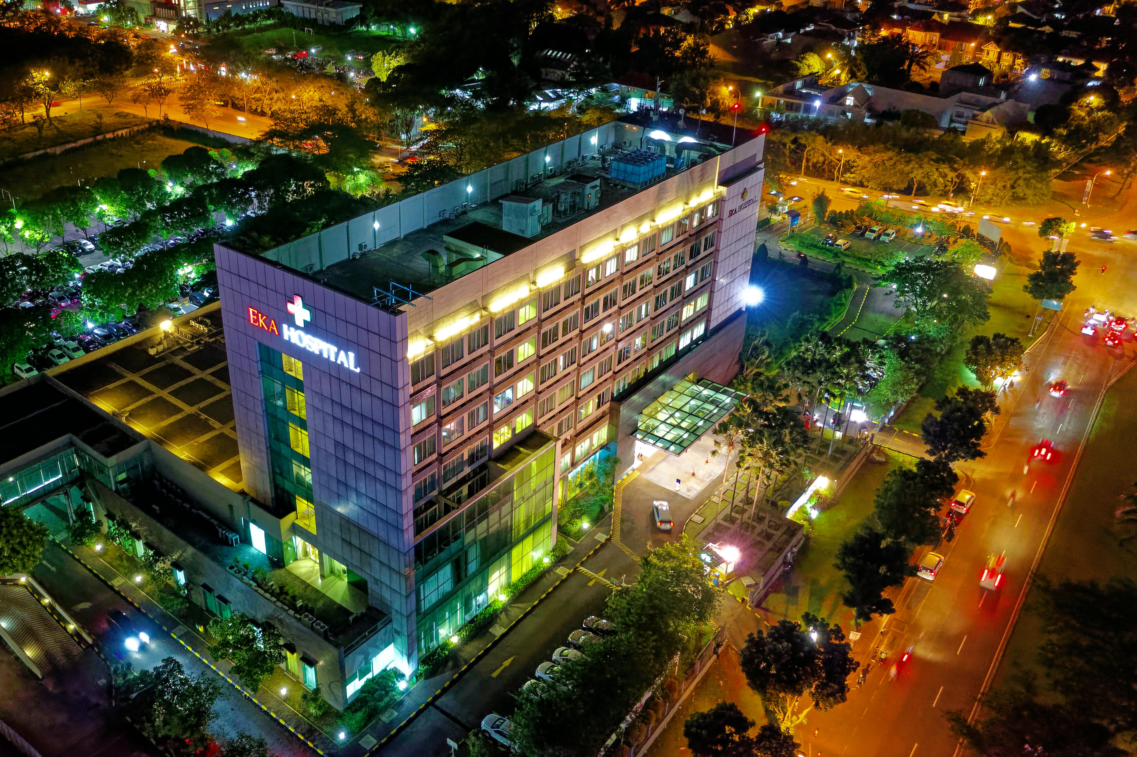
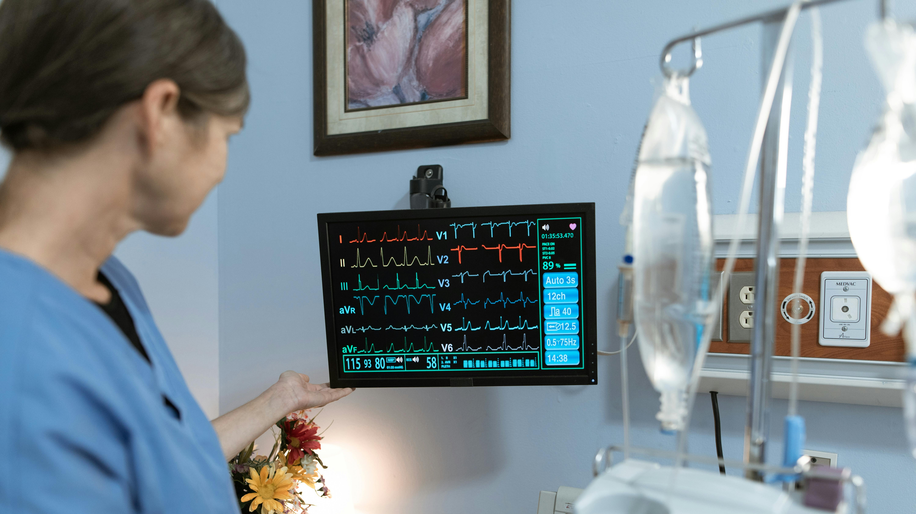

Notes:
Let’s zoom in and think about what we know power **will** do for health.
Home heating during a snowstorm
(hypothermia; carbon monoxide; diabetes; CPAP machine)
Hospital bed whose
ventilator never stops.
IV pump
Neonatal monitor
Refrigerated insulin
Oxygen concentrator
911 call
We’re talking about lives quietly supported by every steady power access and supply
In hospitals, it’s the respirator that never stops, the IV pump that keeps delivering life-saving medicine, and the neonatal monitor that watches over a newborn’s heartbeat. At home, it’s the oxygen concentrator for a grandfather with lung disease, the refrigerator that keeps a child’s insulin safe, the CPAP that helps a mother sleep through the night. It’s clean water flowing from the tap because the treatment plant never lost power — and a 911 call that connects because the tower stayed on.
Reliable electricity is invisible — until it’s gone. And what projects like this line provide is more than energy. They give peace of mind, protect health, and keep the promise that modern life, at its most essential and most human, will continue uninterrupted.

Slide 105
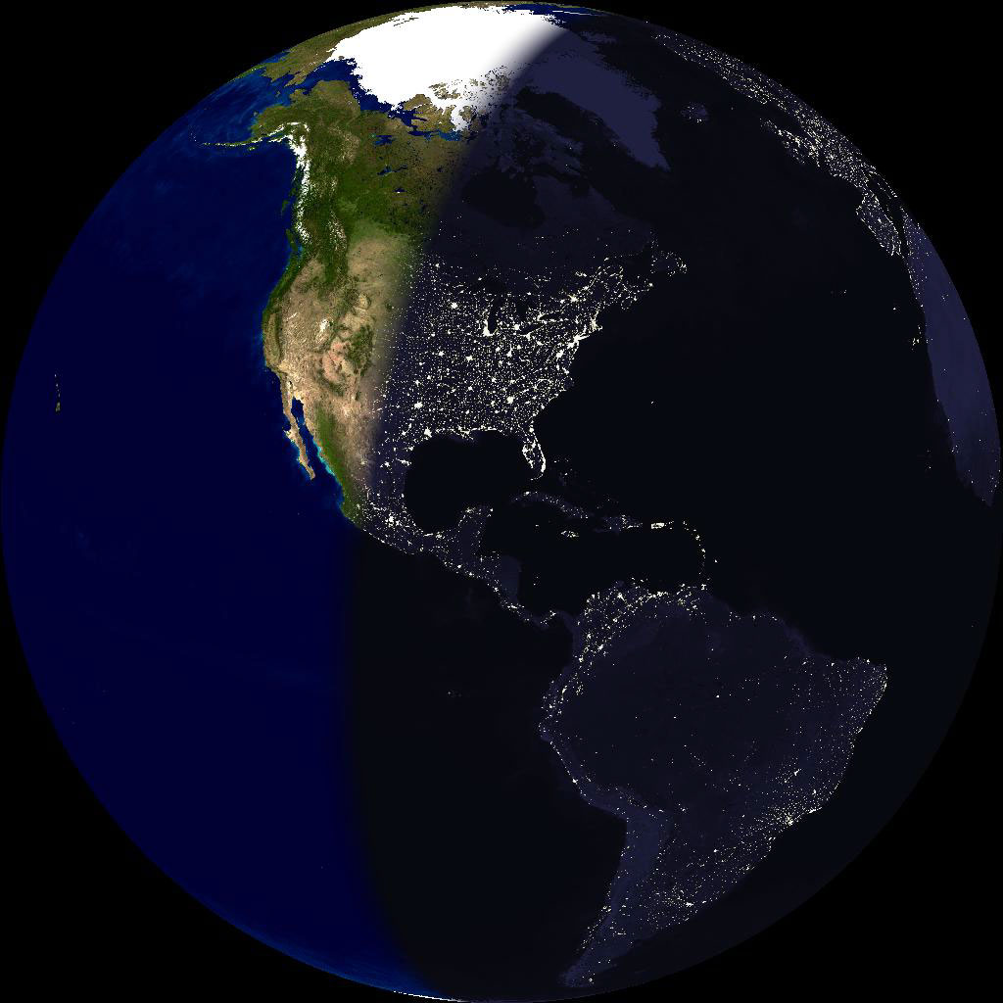
Notes:
Zooming out, for a moment. What we will be covering today:
In developing a transmission line, you need permission from a lot of people. With issues like cancer, I don’t envy the PR folks. Let’s see if we can help them out today.
Some will have open-ended questions like, “what is voltage, and is it bad for me.
“Extremly low frequency sounds scary
“Extra high” voltage sounds leathal
Radiation
Ionizing
carcinogen
Congratulations: You’re evil.
But since there are actually no known health effects of transmission lines, let’s first get inspired by what is known: that reliable power saves lives.

