Slide 1




Slides Key
Research publication
Document
Website
Zooming in
Speaker notes

Slide 2
READ MEDICAL LITERATURE LIKE AN EXPERT Real-World Scientific Method
1. Meaningful Problem | 6. Temporal Relationship
2. Biological Plausibility | 7. Dose Response
3. Hypothesis | 8. Reproducibility
4. Study design / Conduct | 9. Effect size
5. Validity | 10. Peer review
Meaningful problem
Biological plausibility
Hypothesis
Study design & conduct
Validity assessment
6. Temporal relationship
7. Dose response
8. Reproducibility
9. Effect size
10. Peer review / Expert
Notes:
Meaningful problem: kids get cancer
Bio plaus: what are the key factors that might drive the finding
Hypothesis generation: 1979 vs post 1979
Design: RCT vs Observational
Validity: internal (chance, bias, confounding); external (generalizability)
Chance (confidence intervals
Bias (stack the deck
Confound: missing the key factor (Does ice cream consumption cause drowning)
Temporal relationship is about causality (correlation v causation)
Dose response
Reproducible (not just same inner circle)
Effect size: 100% raise from $1/hr to $2/hr
Peer review / Expert opinion

Slide 3
Study Design
Experimental Studies (assign exposure/treatment)
Randomized Controlled Trials (RCTs)
Observational Studies (observe without intervening)
Case-Control Studies
Cohort Studies
Key Difference:
Experimental: Actively control who gets exposed
Observational: Passive; correlate (causality uncertain)
Notes:
This slide introduces the fundamental distinction between observational and experimental research. In observational studies, researchers simply observe and measure what's already happening in the real world without manipulating exposures. People are exposed (or not) based on their own lives, environments, and choices. In experimental studies, researchers actively assign or control the exposure - for example, randomly assigning patients to receive a drug or placebo. This distinction is critical for EMF research because ethical constraints prevent us from conducting experimental studies where we deliberately expose children to electromagnetic fields. The hierarchy of evidence typically places experimental studies (especially RCTs) at the top, but for EMF and childhood leukemia, we must rely entirely on observational designs. Understanding this limitation from the outset helps frame the entire discussion of evidence quality in this field.

Slide 4

Randomized Controlled Trial (RCT)
Pros
Gold standard for proving cause-and-effect
Prospective
Randomly assigns exposure
Reduces chance, bias, confounding
Can calculate true risk
Cons
Expensive and time-consuming
Cannot be done for EMF/MF in humans
Unethical to expose children to potential harm
Long wait for rare diseases like leukemia
Childhood leukemia is rare (3/200,000/yr)
Long wait for result of exposure.
Notes:
childhood leukemia is rare (3-4 cases per 100,000 children per year), so even if ethical, an RCT would require enormous sample sizes and many years of follow-up. This constraint forces researchers to use observational study designs instead.

Slide 5
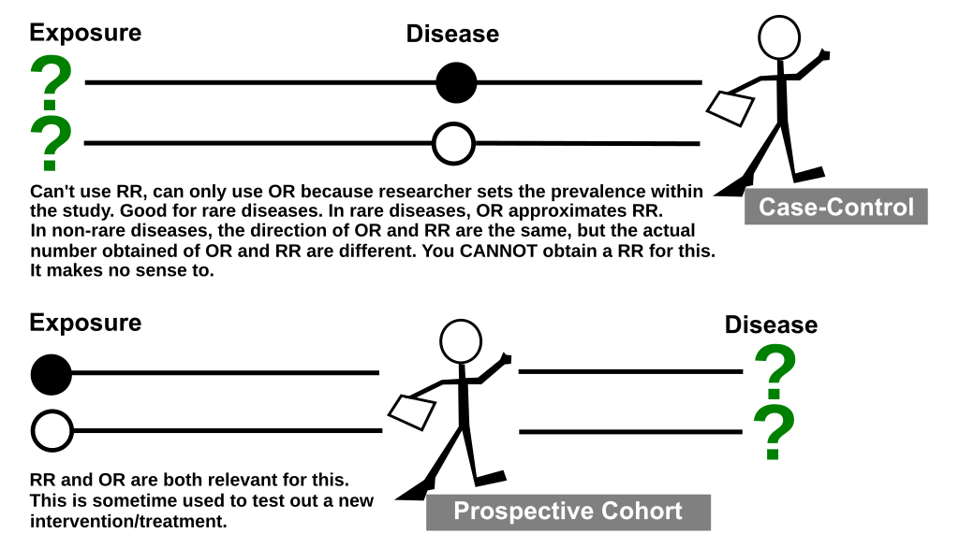
Notes:
Source: wiki

Slide 6
Case-Control Study
Odds Ratio = (a/b) ÷ (c/d) = (a × d) / (b × c)
Breaking it down:
a/b = odds of exposure among cases
c/d = odds of exposure among controls
You're comparing these two odds
Given cases of kids with leukemia [compared to a similar group of kids without leukemia], what are the odds that they were exposed to magnetic fields?
 | Exposed | Not Exposed
Cases | a | b
Controls | c | d
Odds Ratio = (a/b) ÷ (c/d)

Slide 7
Meta-Analysis & Pooled Analysis Combining Multiple Studies
Meta-Analysis
Combines published summary statistics from multiple studies
Uses only what's published in papers
Pooled Analysis
Combines raw data from individual studies
Uses original patient-level data
Notes:
Because individual studies of childhood leukemia often have limited sample sizes and statistical power, combining multiple studies is crucial. There are two approaches: meta-analysis and pooled analysis. Meta-analyses use published summary statistics (like the OR and confidence interval from each paper) and combine them using statistical methods. This is faster but limited by what authors chose to publish and how they analyzed their data. Pooled analyses go further by obtaining the original raw data from each study and reanalyzing everything using standardized methods. This approach is more powerful, allows for better control of confounding, and can examine dose-response relationships more precisely. However, it requires cooperation from original investigators and access to their data. For EMF/leukemia research, several major pooled analyses have been conducted and provide the strongest available evidence. These large combined analyses help overcome the limitation that any single case-control study may be underpowered to detect small increases in risk.

Slide 8
Results Must Use Confidence Interval (CI)
The results of this study is somewhere in this range
Check for significance
If CI spans 1, than not significant (“NS”)
If doesn’t cross 1, then…
Check the effect size
How strong is the association?
Check the precision (narrow CI is precise)
Consider the context - Does it make biological sense? Do other studies agree?

Slide 9
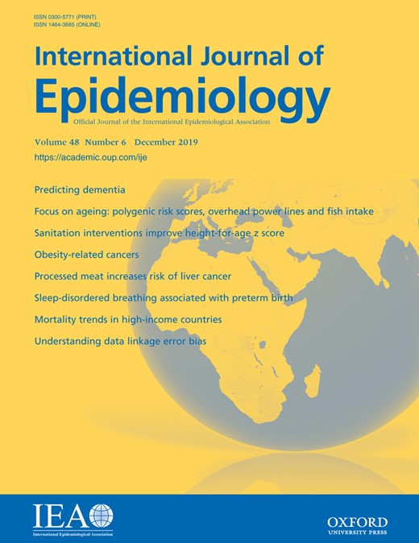
Example: Non-Significant Results Gervasi et al. 2019 - ELF-MF and Neurodegenerative Disease
Methods: case-control study in Milan; 9,835 Alzheimer cases and 6,810 Parkinson cases with matched controls; distance from high-voltage power lines as exposure proxy
Results (living <50m vs ≥600m from power lines):
Alzheimer's dementia: OR = 1.11 (95% CI: 0.95-1.30)
Parkinson's disease: OR = 1.09 (95% CI: 0.92-1.30)
Authors’ incorrect spin:
"The finding of a weak association … suggests the continuation of research on this topic."
"The risk for Alzheimer's dementia and Parkinson's disease tends to be higher in residents living <50 m from high-voltage overhead power lines..."
Notes:
Gervasi F, et al. Residential distance from high-voltage overhead power lines and risk of Alzheimer's dementia and Parkinson's disease: a population-based case-control study in a metropolitan area of Northern Italy. Int J Epidemiol. 2019
Full URL: https://academic.oup.com/ije/article/48/6/1949/5529302
Key Teaching Points:
High-quality study with large sample size and good methodology
Despite quality, both primary findings were non-significant (CIs crossed 1.0)
Authors use softening language: "weak association" and "tends to be higher"
This is misleading
A weak but significant finding would have a CI like 1.05-1.18 (doesn't cross 1.0)
A non-significant finding is not "weak" - it's simply not demonstrated
Always check the CI yourself, don't rely on author interpretations in abstracts or conclusions

Slide 10
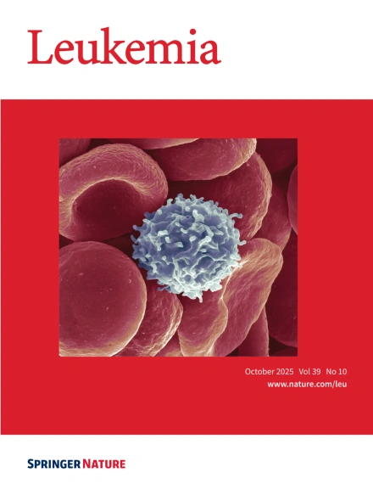
-one-third of all childhood malignancies
-most common form of cancer in children
Lymphoid: the smart immune cells that recognize specific targets (Bs and Ts)
Myeloid: the frontline cells that do general defense, plus red blood cells and platelets.
Notes:
ACUTE LYMPHOBLASTIC LEUKEMIA
ALL/LBL accounts for approximately one-third of all childhood malignancies and is the most common form of cancer in children; ALL/LBL is five times more common in children than acute myeloid leukemia (AML) [1,2]. The distribution of ALL/LBL categories is B lineage (85 percent), T lineage (10 to 15 percent), and NK lineage (<1 percent).
Approximately 3000 new cases of ALL/LBL are diagnosed in children each year in the United States, with an incidence of approximately 3.4 cases per 100,000 [1]. The incidence varies worldwide but this may be influenced, in part, by diagnostic and reporting differences [3]. In the United States, the incidence of ALL/LBL is higher in Latino and White individuals than in Black and Asian individuals [4,5]. The peak incidence of ALL/LBL occurs between ages two to five years, and it is more common among boys than girls [1,4,6,7].
The incidence of childhood leukemia appears to be increasing
Lymphoid → the “smart” immune cells that recognize specific targets (Bs and Ts)
Myeloid → the “frontline” cells that do general defense, plus red blood cells and platelets.
Leukemias are named after which branch goes wrong:
ALL: malignant overgrowth of lymphoid precursors (immature B or T cells).
AML: malignant overgrowth of myeloid precursors (cells that should become red cells, platelets, or granulocytes).

Slide 11
Step 1: The Beginning Wertheimer N, Leeper E. 1979
Case-control study
344 childhood cancer deaths vs. matched controls
1950-1973
Exposure assessment: "Wire code" classification
OR ≈ 2.0-3.0 for various cancer types
No biological plausibility
No magnetic field measurements or calcs
Chance: poor stats rigor
Bias (e.g., unblinded)
Confounding (e.g., SES)
Notes:
Citation
Wertheimer N, Leeper E. Electrical wiring configurations and childhood cancer. Am J Epidemiol. 1979;109(3):273-284.
https://pubmed.ncbi.nlm.nih.gov/453167/
Wertheimer and Leeper's paper launched the field of EMF epidemiology. They noticed that homes near certain power line configurations had more childhood cancer deaths and developed "wire codes" - categories based on the type and proximity of electrical wiring near homes.
Confounding?
Critical insight on wire codes: While wire codes correlate with magnetic fields, they also correlate with many other factors: socioeconomic status (wealthier neighborhoods have underground wiring), housing age (older homes near surface streets have more overhead lines), urban density, and traffic density. This confounding makes it impossible to determine if associations reflect magnetic fields or these other factors.
Biological plausibility was completely absent - no proposed mechanism for how 50-60 Hz magnetic fields at microtesla levels could cause cancer. No animal models supported the association. The study was purely observational pattern recognition.
The temporal relationship problem: Using death certificates rather than birth addresses means we don't know if children lived near power lines before diagnosis or moved there afterward. For diseases with long latency like leukemia, establishing that exposure preceded disease is critical.
Historical context: In 1979, direct magnetic field measurement devices were not readily available for epidemiological studies. Wire codes were a practical, if imperfect, solution. Savitz (1988) would later add actual measurements.
Bottom line: Important for raising the question, but methodologically limited. Requires replication with better exposure assessment and control of confounding. This is exactly what subsequent research attempted to do.

Slide 12
Step 2: Blinded and Measured Savitz et al. 1988 - Denver Childhood Cancer Study
Addresses blinding problem
Measures magnetic fields
Study Design:
356 childhood cancer cases (age 0-14), 356 controls
Denver metro area, 1976-1983 diagnoses
Blinded in-home magnetic field measurements (low/high power use)
Wire codes assessed for comparison
Notes:
Savitz DA, Wachtel H, Barnes FA, John EM, Tvrdik JG. Case-control study of childhood cancer and exposure to 60-Hz magnetic fields. Am J Epidemiol. 1988;128(1):21-38.
https://pubmed.ncbi.nlm.nih.gov/3164167/
Directly addressed W&L's main weakness by conducting blinded assessment
Field measurements taken under two conditions: low power (nighttime, minimal appliances) and high power (daytime, appliances on)
Low power measurements thought to better represent chronic background exposure
Wire code results similar to W&L, suggesting replication
Weaker association with measured fields puzzling - suggested either wire codes capture something beyond current magnetic fields, or measurement error in spot measurements
Authors noted limitations: nonresponse for field measurements, differential mobility between cases and controls, exposure misclassification from imperfect surrogates
Study encouraged further research but fell short of demonstrating causation
Led to decades of research trying to resolve wire code vs. measured field discrepancy

Slide 13
Step 2– Blinded and Measured Savitz et al. 1988 - Denver Childhood Cancer Study
Paradoxical Results:
Confirms wire codes associated with cancer: OR = 1.5 (CI 1.0-2.3)
But Measured fields (>2mG) not associated with cancer
blinded study; field measurements
Origin of the "wire code paradox”
“the results encourage further examination of the carcinogenic potential from this form of nonionizing radiation”
Notes:
Savitz DA, Wachtel H, Barnes FA, John EM, Tvrdik JG. Case-control study of childhood cancer and exposure to 60-Hz magnetic fields. Am J Epidemiol. 1988;128(1):21-38.
https://pubmed.ncbi.nlm.nih.gov/3164167/
Directly addressed W&L's main weakness by conducting blinded assessment
Field measurements taken under two conditions: low power (nighttime, minimal appliances) and high power (daytime, appliances on)
Low power measurements thought to better represent chronic background exposure
Wire code results similar to W&L, suggesting replication
Weaker association with measured fields puzzling - suggested either wire codes capture something beyond current magnetic fields, or measurement error in spot measurements
Authors noted limitations: nonresponse for field measurements, differential mobility between cases and controls, exposure misclassification from imperfect surrogates
Study encouraged further research but fell short of demonstrating causation
Led to decades of research trying to resolve wire code vs. measured field discrepancy

Slide 14
Step 3
Lots of studies in the 1990’s, mostly non-significant findings
Best was Linet 1997
Congress launches EMF RAPID program in the 1992 Energy Policy Act: Request for NIH to evaluate health effects.
RAPID Program

Slide 15

Step 3—Pooled Analyses
Two major pooled analyses published in 2000 both found elevated risk of measured magnetic fields
Notes:
Ahlbom A, et al. A pooled analysis of magnetic fields and childhood leukaemia. British Journal of Cancer. 2000
https://www.nature.com/articles/6691376
Greenland S, Sheppard AR, Kaune WT, Poole C, Kelsh MA, for the Childhood Leukemia-EMF Study Group. A pooled analysis of magnetic fields, wire codes, and childhood leukemia. Epidemiology. 2000
https://www.jstor.org/stable/3703814

Slide 16
Step 3—Pooled Analyses
Ahlbom A, et al. 2000
“A pooled analysis of magnetic fields and childhood leukaemia.”
British Journal of Cancer.
Greenland S, et al 2000
“A pooled analysis of magnetic fields, wire codes, and childhood leukemia.”
Epidemiology.
Notes:
Ahlbom A, et al. A pooled analysis of magnetic fields and childhood leukaemia. British Journal of Cancer. 2000
https://www.nature.com/articles/6691376
Greenland S, Sheppard AR, Kaune WT, Poole C, Kelsh MA, for the Childhood Leukemia-EMF Study Group. A pooled analysis of magnetic fields, wire codes, and childhood leukemia. Epidemiology. 2000
https://www.jstor.org/stable/3703814

Slide 17
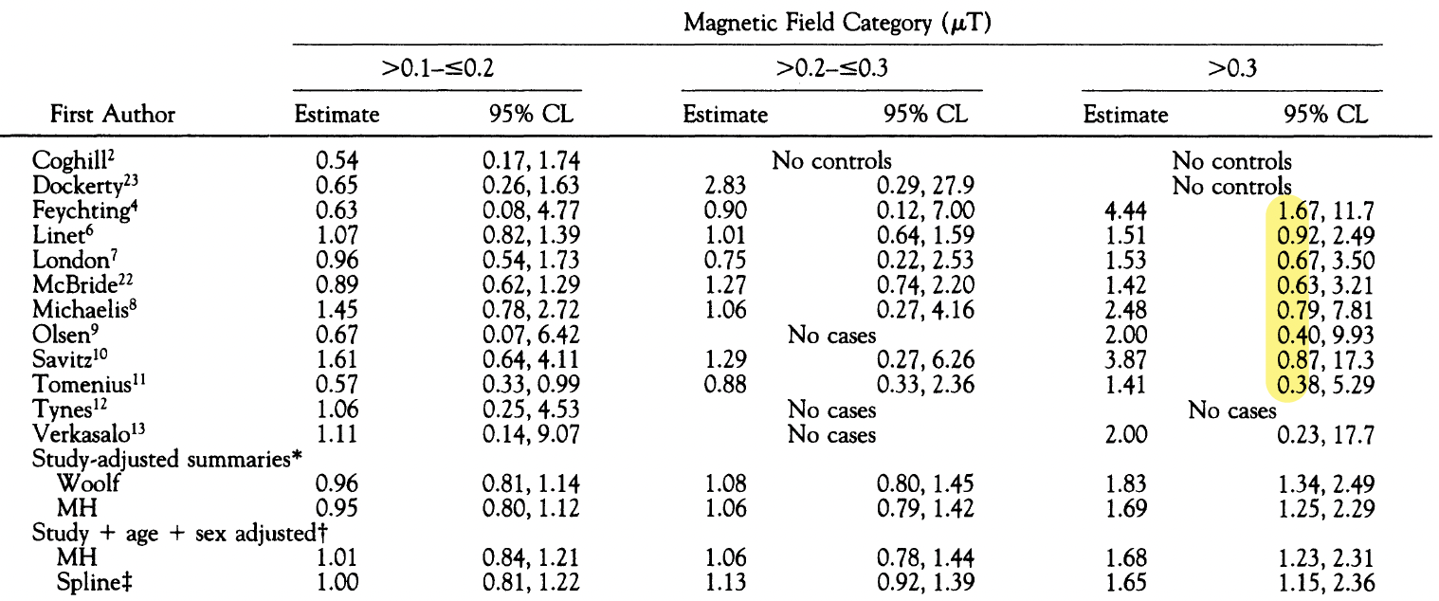
Step 3—Pooled Analyses
Most of shared studies were themselves null results.
Notes:
Only ONE study had statistically significant results:
Feychting: OR = 4.44 (95% CI: 1.67-11.7)
All other studies had CIs crossing 1.0:
Linet: OR = 1.51 (0.92-2.87)
London: OR = 1.53 (0.67-3.50)
McBride: OR = 1.42 (0.63-3.21)
Michaelis: OR = 2.48 (0.79-7.81)
Olsen: OR = 2.00 (0.40-9.93)
Savitz: OR = 3.87 (0.87-17.3)
Tomenius: OR = 1.41 (0.38-5.29)
Verkasalo: OR = 2.00 (0.23-17.7)

Slide 18
Step 3—Pooled Analyses
Most of shared studies were themselves null results.
Notes:
Only ONE study had statistically significant results:
Feychting: OR = 4.44 (95% CI: 1.67-11.7)
All other studies had CIs crossing 1.0:
Linet: OR = 1.51 (0.92-2.87)
London: OR = 1.53 (0.67-3.50)
McBride: OR = 1.42 (0.63-3.21)
Michaelis: OR = 2.48 (0.79-7.81)
Olsen: OR = 2.00 (0.40-9.93)
Savitz: OR = 3.87 (0.87-17.3)
Tomenius: OR = 1.41 (0.38-5.29)
Verkasalo: OR = 2.00 (0.23-17.7)

Slide 19
Step 3—Pooled Analyses
Why impactful?
Both found similar ORs (~1.7-2.0) at high exposure
Wire-code paradox now gone
Illusion of two findings
Notes:
Getting rid of wire-code paradox meant less concern about confounding from wire codes

Slide 20
Step 4
Insert IARC (WHO) here

Slide 21
Step 5
More studies, more confusion (insert Draper)

Slide 22
Step 5
Decaying finding…

Slide 23
Example: Non-Significant Finding in Major Study Kheifets 2010 - Pooled Analysis of EMF and Childhood Leukemia
Methods: Pooled 7 case-control studies; 10,865 cases and 12,853 controls; measured or calculated residential magnetic field exposure
Results: High exposure (≥0.3 μT): O.R. = 1.44 (95% CI: 0.88-2.36)
Conclusions:
“Our results are in line with previous pooled analyses showing an association between magnetic fields and childhood leukaemia. Overall, the association is weaker in the most recently conducted studies, but these studies are small and lack methodological improvements needed to resolve the apparent association. We conclude that recent studies on magnetic fields and childhood leukaemia do not alter the previous assessment that magnetic fields are possibly carcinogenic.”
Notes:
L Kheifets, A Ahlbom, C M Crespi, G Draper, J Hagihara, R M Lowenthal, G Mezei, S Oksuzyan, J Schüz, J Swanson, A Tittarelli, M Vinceti, V Wunsch Filho
Pooled analysis of recent studies on magnetic fields and childhood leukaemia. British Journal of Cancer. 2010;103(7):1128-1135. doi:10.1038/sj.bjc.6605838
Full URL: https://www.nature.com/articles/6605838
Complete Author List with Affiliations:
L Kheifets - Department of Epidemiology, UCLA School of Public Health, University of California, Los Angeles, USA
A Ahlbom - Division of Epidemiology, Institute of Environmental Medicine, Karolinska Institute, Stockholm, Sweden
C M Crespi - Department of Biostatistics, UCLA School of Public Health, University of California, Los Angeles, USA
G Draper - Childhood Cancer Research Group, University of Oxford, Oxford, UK
J Hagihara - Department of Public Health, Jichi Medical University, Tochigi, Japan
R M Lowenthal - Menzies Centre for Population Health Research, University of Tasmania, Tasmania, Australia
G Mezei - EXPONENT Inc., Menlo Park, CA, USA
S Oksuzyan - Department of Epidemiology, UCLA School of Public Health, University of California, Los Angeles, USA
J Schüz - Institute of Cancer Epidemiology, Danish Cancer Society, Copenhagen, Denmark
J Swanson - National Grid, UK
A Tittarelli - Epidemiology Unit, National Cancer Institute, Milan, Italy
M Vinceti - CREAGEN Environmental Epidemiology Centre, Department of Public Health Sciences, University of Modena, Italy
V Wunsch Filho - School of Public Health, University of São Paulo, Brazil
Key Recurring Authors:
Leeka Kheifets (UCLA) - Appears on:
Kheifets 2010 pooled analysis
Multiple California Power Line Studies
Numerous meta-analyses and reviews
She's essentially the lead US researcher on this topic
Anders Ahlbom (Karolinska Institute, Sweden) - Appears on:
Ahlbom 2000 pooled analysis (one of the landmark studies)
Kheifets 2010
Multiple Swedish studies
John Swanson (National Grid, UK) - Appears on:
Kheifets 2010
Draper 2005 (the UK power lines study we discussed)
Kroll 2010 (follow-up to Draper)
Multiple UK studies
Note: He works for National Grid (the power company) - potential conflict of interest
Gerald Draper (Oxford) - Appears on:
Draper 2005 (lead author)
Kheifets 2010
Multiple UK childhood cancer studies
Joachim Schüz (Danish Cancer Society, now IARC) - Appears on:
Kheifets 2010
Multiple European studies
Now works at IARC (International Agency for Research on Cancer)
Catherine Crespi (UCLA Biostatistics) - Appears on:
Kheifets 2010
Multiple California studies
Collaborates frequently with Kheifets

Slide 24
Kheifets 2017 - California Power Line Study (CAPS)
Methods: case-control study; 5,788 childhood leukemia cases, matched controls; Results (highest exposure ≥0.4 μT vs <0.1 μT):
Main analysis: OR = 1.50 (95% CI: 0.70-3.23)
All exposure categories: All confidence intervals crossed 1.0 (not significant)
Authors' Statements:
”…does not in itself provide clear evidence of risk …but could be viewed as consistent with previous findings of increased risk."
Notes:
Kheifets L, Crespi CM, Hooper C, et al. Residential magnetic fields exposure and childhood leukemia: a population-based case-control study in California. Cancer Causes Control. 2017;28(10):1117-1129. doi:10.1007/s10552-017-0951-6
Full URL: https://pubmed.ncbi.nlm.nih.gov/28900736/ https://pmc.ncbi.nlm.nih.gov/articles/PMC5706765/
The honest conclusion would be: "Our study found no statistically significant associations between residential magnetic field exposure and childhood leukemia risk. While point estimates in the highest exposure group suggested possible increased risk (OR=1.50), wide confidence intervals (0.70-3.23) indicate this finding is compatible with no effect."
This is Leeka Kheifets again - lead US researcher on this topic
Very large, well-designed study (5,788 cases!)
Funded by the Electric Power Research Institute (industry funding)
Despite size and quality, NO statistically significant findings
Notice pattern: Kheifets authored both the 2010 pooled analysis AND this 2017 California study, both with non-significant results, both framed as "consistent with" previous findings

Slide 25
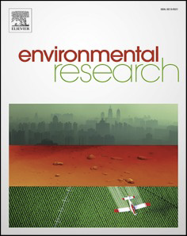
“Usual Suspects” – null result Amoon et al. 2022 - Pooled Analysis of Recent Studies
Methods: Pooled analysis of 4 recent studies (22,128 cases, 27,587 controls) on magnetic fields and childhood leukemia
Results:
≥0.4 μT vs <0.1 μT: OR = 1.01 (95% CI 0.61-1.66)
No increased risk of leukemia with magnetic field exposure
First pooled analysis to find essentially null results
Authors' Framing:
“Our results are not in line with previous pooled analysis and show a decrease in effect to no association between MF and childhood leukemia. This could be due to methodological issues, random chance, or a true finding of disappearing effect.”
Notes:
Citation: Amoon AT, Swanson J, Magnani C, Johansen C, Kheifets L. Pooled analysis of recent studies of magnetic fields and childhood leukemia. Environ Res. 2022;204(Pt A):111993. doi:10.1016/j.envres.2021.111993
Full URL: https://pubmed.ncbi.nlm.nih.gov/34481821/
Even the research group most invested in finding an association - with decades of work on this topic - now cannot demonstrate one in their most recent pooled analysis.
This is the same Kheifets who:
Led the 2010 pooled analysis (non-significant, framed as "consistent with" prior findings)
Led the 2017 CAPS study (non-significant, "could be viewed as consistent with" prior findings)
Now leads the 2022 pooled analysis (null result)
At what point do repeated null findings by the field's leading researchers constitute evidence against the association rather than "consistency with" decades-old positive findings?
Key Teaching Points:
This is the most recent major pooled analysis (2022) from the leading research group
First pooled analysis to find no association - a dramatic shift from Ahlbom 2000, Greenland 2000, and even Kheifets 2010
Same authors who have been publishing on this topic for 20+ years
Pattern across their work: Kheifets 2010 (marginal), CAPS 2017 (null), Amoon 2022 (null)
When the researchers most invested in the hypothesis can no longer find an association, that's meaningful
Compare this to Brabant 2022 (independent researchers) who also found association only in pre-2000 studies
The convergence of evidence - both the "insiders" (Kheifets group) and "outsiders" (Brabant group) now show weakening/absent associations in recent data
How many null findings does it take before we conclude there's no association, rather than continuing to reference positive findings from 25 years ago?

Slide 26
Kheifets, An Evolution
2010 study Not Significant (NS). But claimed "In line with previous analyses showing an association"
2017 study NS. But claimed "Could be viewed as consistent with previous findings of increased risk"
2022 pooled study; NS: Finally relented. "Not in line with previous analysis…could be due to a disappearing effect.”
[These findings disappeared decades ago.]

Slide 27

Weakening Association Brabant et al. 2022 - Systematic Review & Meta-Analysis
Authors: Christian Brabant, Anton Geerinck, Charlotte Beaudart, Ezio Tirelli, Christophe Geuzaine, Olivier Bruyère (University of Liège)
Methods: Systematic review and meta-analysis of 38 studies on ELF magnetic fields (50-60 Hz) and childhood leukemia; assessed study quality using Newcastle-Ottawa Scale
Results 1:
Association Weakens Dramatically Over Time:
Studies before 2000: Pooled OR = 1.51 (95% CI: 1.26-1.80)
Studies after 2000 not significant: Pooled OR = 1.04 (95% CI: 0.84-1.29)

Slide 28
Brabant 2022, Systematic Review and Meta-analysis
Review and analysis of 38 studies (1979–2020)
21 entered the main ("global") meta-analysis.
Finding | Pooled OR (95% CI)
Main pooled analysis | 1.26 (1.06–1.49)
> 0.4 µT exposure group | 1.37 (1.05–1.80)
Authors’ conclusion: “Our global meta-analysis indicates a significant association between ELF-MF and childhood leukemia.” (p.19)

Slide 29
Brabant 2022, Systematic Review and Meta-analysis
Chance:
“Our protocol published in Prospero (2018) mentioned that we have planned to restrict our meta-analysis to children under the age of 15.” (p.3)
The results of that pre-planned finding were not significant: 1.13 (95% CI 0.92–1.39; p=0.23) (p.15)

Slide 30
Brabant 2022, Systematic Review and Meta-analysis
Selection bias:
Brabant selectively excluded parts of four large, null studies (Savitz 1988, Linet 1997, Green 1999, McBride 1999) from the global meta-analysis.
Temporal bias:
Studies before 2000: OR 1.51 (1.26–1.80)
Studies after 2000 not significant: 1.04 (0.84–1.29).

Slide 31
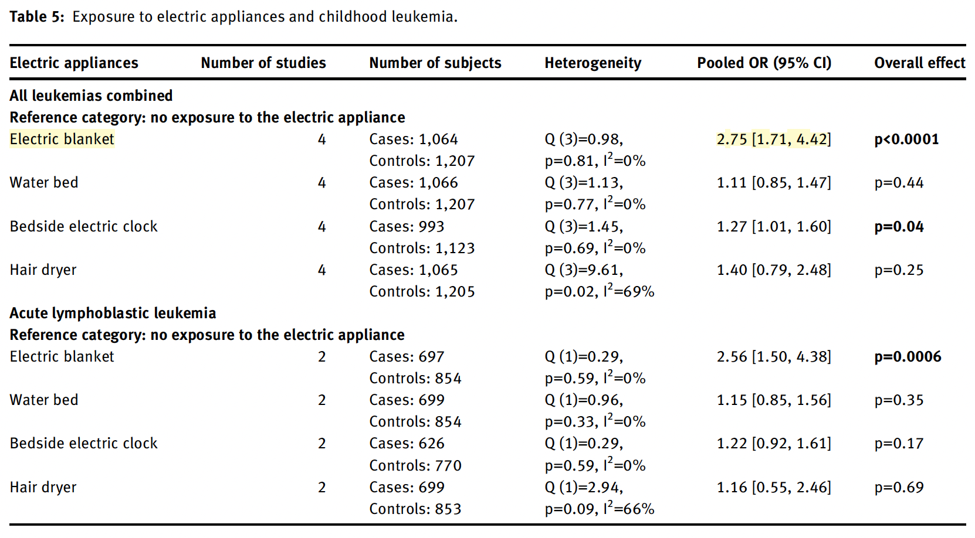
Brabant 2022, Systematic Review and Meta-analysis
Confounding:
Notes:
The Newcastle–Ottawa Scale (NOS) rates observational study quality out of nine points across selection, comparability, and exposure. Scores of 6–7 indicate only moderate quality; Brabant’s findings therefore rely on evidence with notable methodological limitations.
The global finding is an illusion of selective inclusion and historical bias. Once you account for study quality, timing, and confounding, the risk evaporates.
Quality data:
Most studies rated 6–7/9 on Newcastle–Ottawa Scale; none >7.
Major heterogeneity across exposure metrics and eras.

Slide 32
Brabant 2022, Systematic Review and Meta-analysis
Confounding:
Notes:
The Newcastle–Ottawa Scale (NOS) rates observational study quality out of nine points across selection, comparability, and exposure. Scores of 6–7 indicate only moderate quality; Brabant’s findings therefore rely on evidence with notable methodological limitations.
The global finding is an illusion of selective inclusion and historical bias. Once you account for study quality, timing, and confounding, the risk evaporates.
Quality data:
Most studies rated 6–7/9 on Newcastle–Ottawa Scale; none >7.
Major heterogeneity across exposure metrics and eras.

Slide 33
Brabant 2022, Systematic Review and Meta-analysis
Quality data:
Most studies rated as lower quality
Major heterogeneity across exposure metrics and eras.
Notes:
The Newcastle–Ottawa Scale (NOS) rates observational study quality out of nine points across selection, comparability, and exposure. Scores of 6–7 indicate only moderate quality; Brabant’s findings therefore rely on evidence with notable methodological limitations.
The global finding is an illusion of selective inclusion and historical bias. Once you account for study quality, timing, and confounding, the risk evaporates.
Quality data:
Most studies rated 6–7/9 on Newcastle–Ottawa Scale; none >7.
Major heterogeneity across exposure metrics and eras.

Slide 34
Brabant 2022, Systematic Review and Meta-analysis
Take-home:
Their finding arises from
selection bias
legacy data (pre-2000)
Confounders (e.g., electric blankets) might explain much of the old signal.
The totality of modern evidence aligns with no causal link between ELF-MF and childhood leukemia.

Slide 35

IARC (WHO) 2024
Given these decades-long null results since their statement in 2002, surely the IARC (WHO) will change classification, no?
Grade 2B still or no?

Slide 36

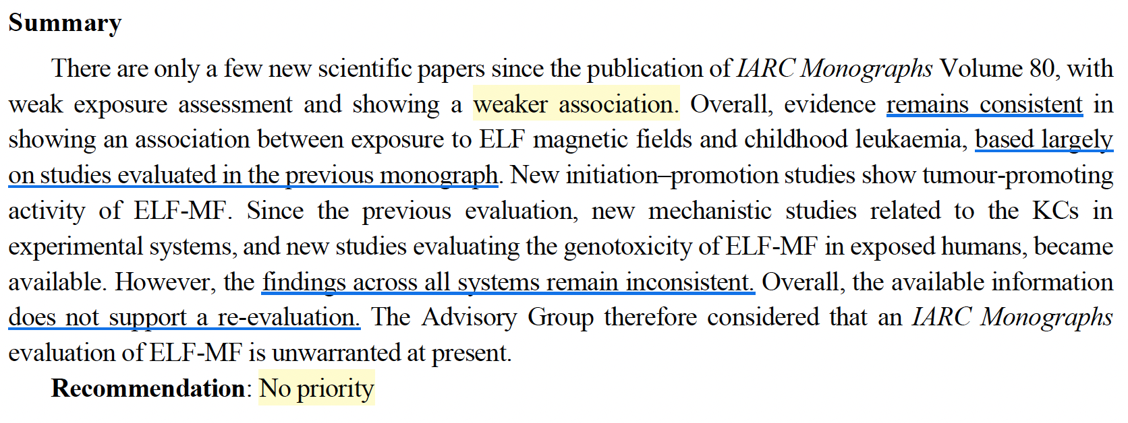
IARC on ELF-MF 2024
IARC Advisory Group Report, 2024, p.171
Notes:
Classification basis: Group 2B classification driven by epidemiologic association with childhood leukaemia, not established causation
Supporting evidence: Based on pooled analyses:
Ahlbom et al. (2000): twofold increased risk (OR 2.00) at exposures ≥0.4 µT (≥4 mG)
Greenland et al. (2000): OR 1.7 at exposures ≥0.3 µT (≥3 mG)
Both studies cited in IARC Vol. 80, p. 338
Current status: 2024 IARC Advisory Group did not recommend re-evaluation through 2029, stating "Existing evidence does not appear to support a change in classification”
Sources:
IARC Monograph Vol. 80 (2002) p. 338 https://www.ncbi.nlm.nih.gov/books/NBK390729/
IARC Advisory Group Report (2024): https://monographs.iarc.who.int/wp-content/uploads/2024/11/AGP_Report_2025-2029.pdf
“Existing evidence does not appear to support a change in classification” (p.7)
Summary:
“There are only a few new scientific papers since the publication of IARC Monographs Volume 80, with weak exposure assessment and showing a weaker association. Overall, evidence remains consistent in showing an association between exposure to ELF magnetic fields and childhood leukaemia, based largely on studies evaluated in the previous monograph. New initiation–promotion studies show tumour-promoting activity of ELF-MF. Since the previous evaluation, new mechanistic studies related to the KCs in experimental systems, and new studies evaluating the genotoxicity of ELF-MF in exposed humans, became available. However, the findings across all systems remain inconsistent. Overall, the available information does not support a re-evaluation. The Advisory Group therefore considered that an IARC Monographs evaluation of ELF-MF is unwarranted at present.
Recommendation: No priority” page 171

Slide 37
IARC Advisory Group Report, 2024, p.171
Notes:
Classification basis: Group 2B classification driven by epidemiologic association with childhood leukaemia, not established causation
Supporting evidence: Based on pooled analyses:
Ahlbom et al. (2000): twofold increased risk (OR 2.00) at exposures ≥0.4 µT (≥4 mG)
Greenland et al. (2000): OR 1.7 at exposures ≥0.3 µT (≥3 mG)
Both studies cited in IARC Vol. 80, p. 338
Current status: 2024 IARC Advisory Group did not recommend re-evaluation through 2029, stating "Existing evidence does not appear to support a change in classification”
Sources:
IARC Monograph Vol. 80 (2002) p. 338 https://www.ncbi.nlm.nih.gov/books/NBK390729/
IARC Advisory Group Report (2024): https://monographs.iarc.who.int/wp-content/uploads/2024/11/AGP_Report_2025-2029.pdf
“Existing evidence does not appear to support a change in classification” (p.7)
Summary:
“There are only a few new scientific papers since the publication of IARC Monographs Volume 80, with weak exposure assessment and showing a weaker association. Overall, evidence remains consistent in showing an association between exposure to ELF magnetic fields and childhood leukaemia, based largely on studies evaluated in the previous monograph. New initiation–promotion studies show tumour-promoting activity of ELF-MF. Since the previous evaluation, new mechanistic studies related to the KCs in experimental systems, and new studies evaluating the genotoxicity of ELF-MF in exposed humans, became available. However, the findings across all systems remain inconsistent. Overall, the available information does not support a re-evaluation. The Advisory Group therefore considered that an IARC Monographs evaluation of ELF-MF is unwarranted at present.
Recommendation: No priority” page 171

Slide 38

“It is sad that hundreds of millions of dollars have gone into studies that never had much promise of finding a way to prevent the tragedy of cancer in children”
Edward Campion, MD.
Editorial: Power lines, cancer, and fear. The New England Journal of Medicine. 1997.

Slide 39
End (leukemia section)

Slide 41
Timeline [see slide notes]
Notes:
Work in progress:
1979: Wertheimer & Leeper
1980s: Wire Paradox
1990s: NIH calls evidence "weak”
1998: ICNIRP guidelines (adopted by much of EU)
2000: Pooled analyses (Ahlbom & Greenland) re-awaken concerns
2002: IARC (WHO): ELF-EMF classified as “2B carcinogen”
2005: More studies, more flaws (e.g., Draper)
2010: Kheifets pooled shows OR = 1.46 (NS)
2010: ICNIRP guidelines updated
2014: Draper extension shows temporal decline
2017: CAPS shows OR = 1.4 (NS)
2019: CAPS analysis suggests not magnetic fields
2022: Kheifets relents [pooled shows OR = 1.01 (null)]
2022: Brabant shows finding null post 2000, electric blanket as possible confound for earlier studies
2024: Institutional Inertia: IARC acknowledges weakening evidence but maintains 2B classification

Slide 42
Cohort Study
Direction: Forward-looking
Compare people with different EMF exposures and see who develops leukemia
Pros
Can calculate true risk
Studies natural exposures (no ethical issues)
Can study multiple outcomes
Good for common exposures
Cons
Very expensive for rare diseases
Takes many years
People may move or drop out
Hard to measure past exposures accurately
Statistical Measure: Relative Risk (RR)
RR = (Risk in exposed) ÷ (Risk in unexposed)
RR = 2.0 means exposed group has twice the risk
Notes:
Cohort studies follow people forward in time, observing natural variation in exposure. Unlike RCTs, researchers don't assign exposure - they simply measure it and follow participants. This avoids ethical issues since we're observing what naturally occurs. Cohort studies can calculate true relative risk because we know the denominators (total number of exposed and unexposed people).
childhood leukemia, cohort studies are extremely expensive and impractical. To detect a rare outcome, you'd need to follow tens of thousands of children for many years. Additionally, accurately measuring historical EMF exposure is challenging - families move, exposure sources change, and recall of past conditions is difficult. For these reasons, very few cohort studies exist in the EMF/leukemia literature.

Slide 43
Main takeaways
1. Study Design Hierarchy vs. Reality
Gold standard = RCT
We must rely on observational studies (case-control designs)
2. Case-Control Studies Dominate EMF Research
Childhood leukemia is rare (3-4 cases per 100,000 children/year)
Following thousands of children for years is impractical. Starting with cases and looking backward is more efficient
3. RR vs OR - What Matters
greater than 1 means increased association
4. Why Meta-Analyses and Pooled Analyses Matter
Individual studies may be too small to detect small effects
Combining studies increases statistical power but adds other problems
5. Limitations to Remember
Association does not equal causation
Chance, Bias and confounding

Slide 44
Understanding Statistical Measures
Relative Risk (RR)
Used in: RCTs and Cohort Studies (forward-looking)
Formula: Risk in exposed ÷ Risk in unexposed
Example:
4 out of 100 exposed children develop leukemia (4% risk)
2 out of 100 unexposed children develop leukemia (2% risk)
RR = 4% ÷ 2% = 2.0
Interpretation: Exposed children have twice the risk
Key insight:
RR > 1 = increased risk with exposure
RR = 1 = no association
RR < 1 = decreased risk with exposure
Odds Ratio (OR)
Used in: Case-Control Studies (backward-looking)
Formula: OR = (Odds of exposure in cases) ÷ (Odds of exposure in controls)
Key insight:
When disease is rare (like childhood leukemia), OR ≈ RR
OR > 1 = increased odds with exposure
OR = 1 = no association
OR < 1 = decreased odds with exposure
For EMF studies, most studies are case-control and report OR.

